Slide 1
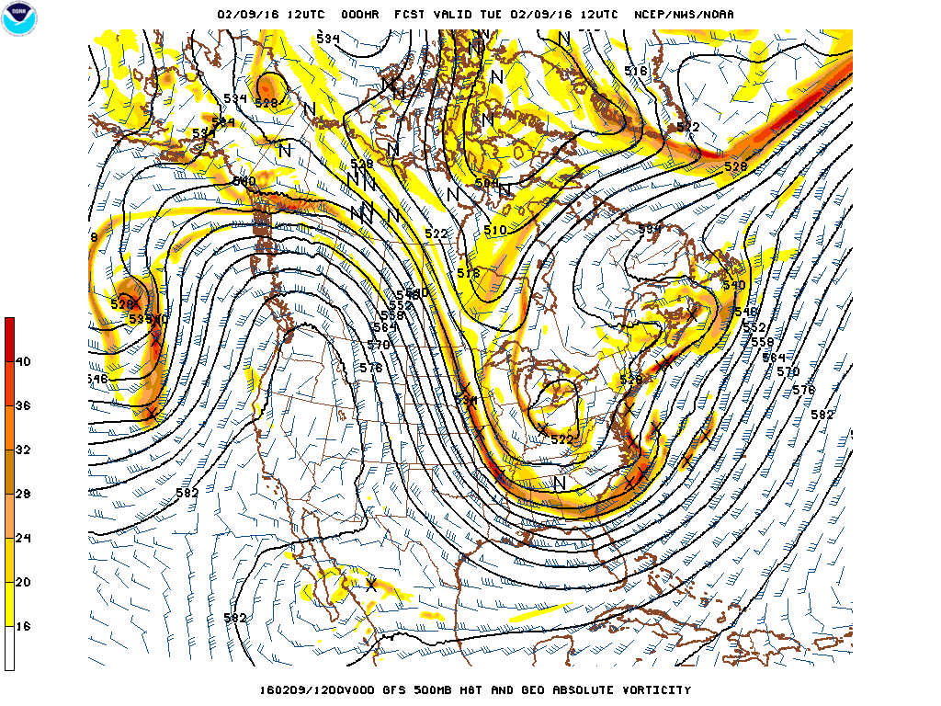
0 h forecast

Slide 2
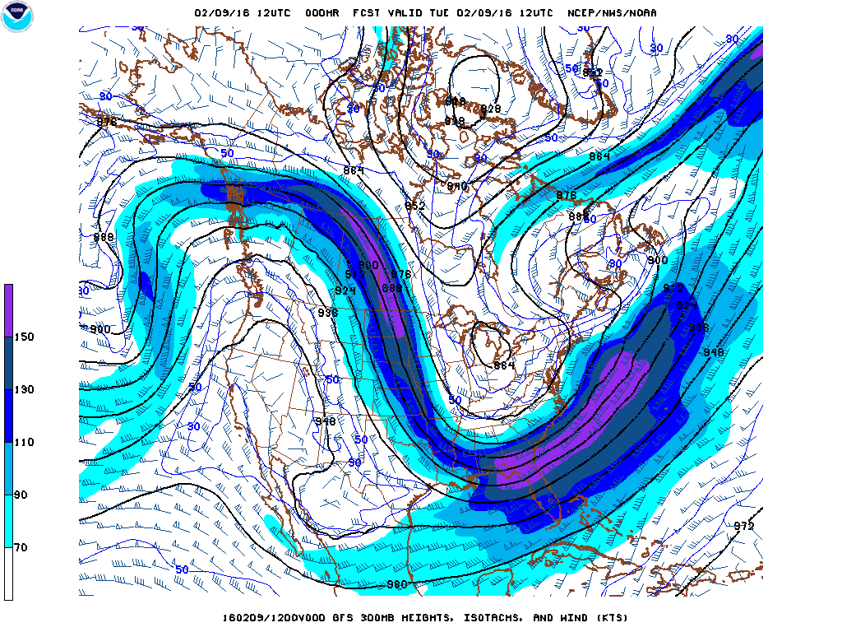
0 h forecast

Slide 3
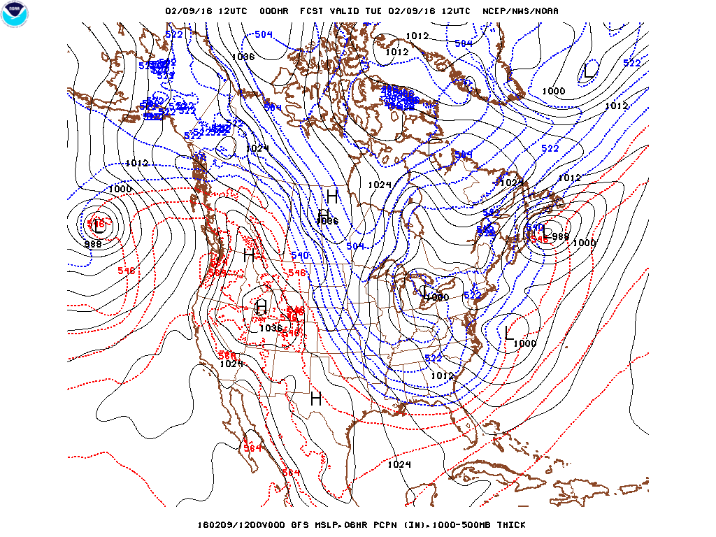
0 h forecast

Slide 4
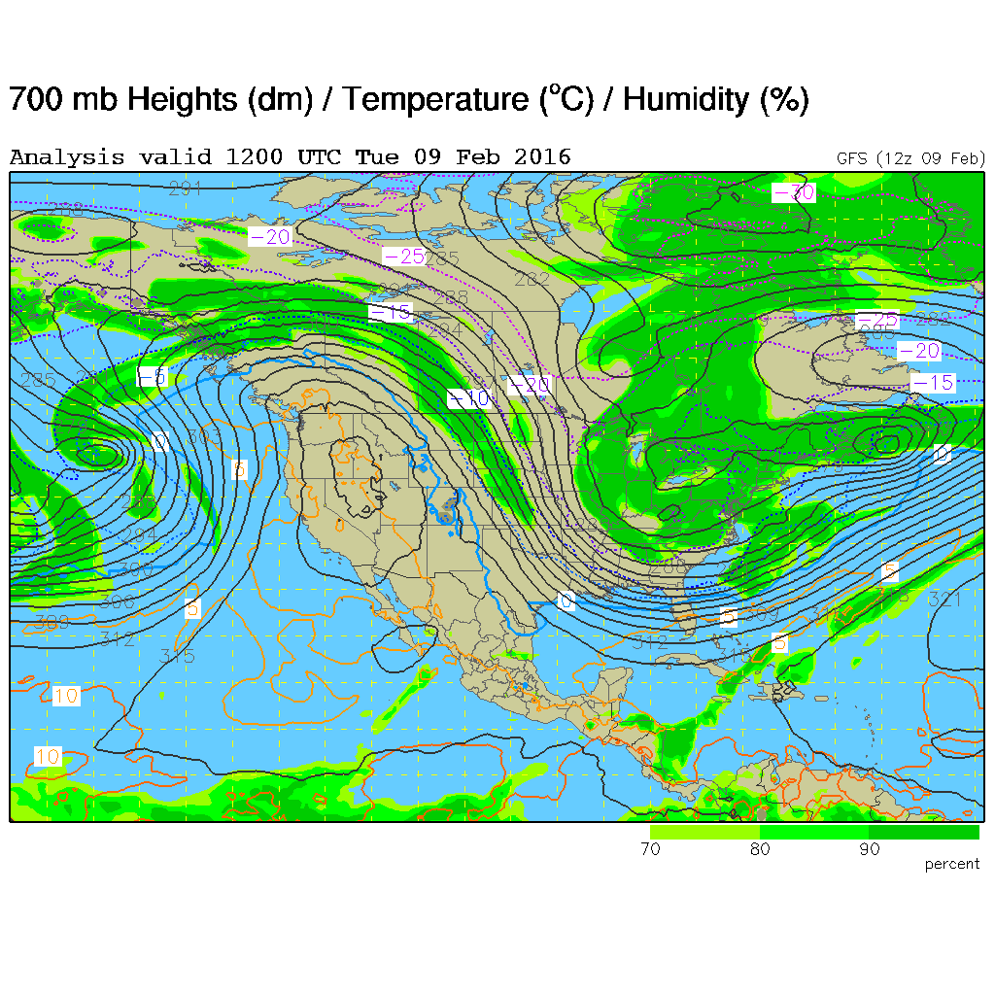
0 h forecast

Slide 5
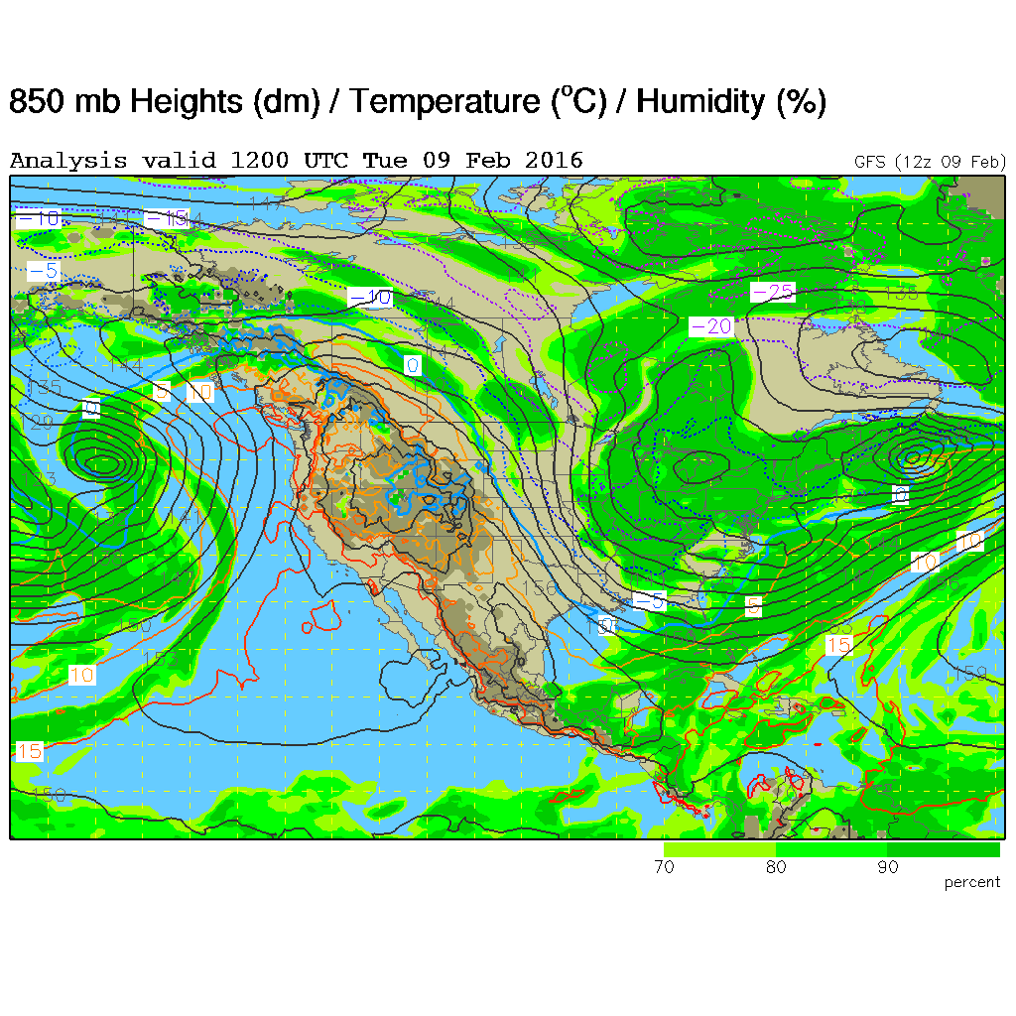
0 h forecast

Slide 6
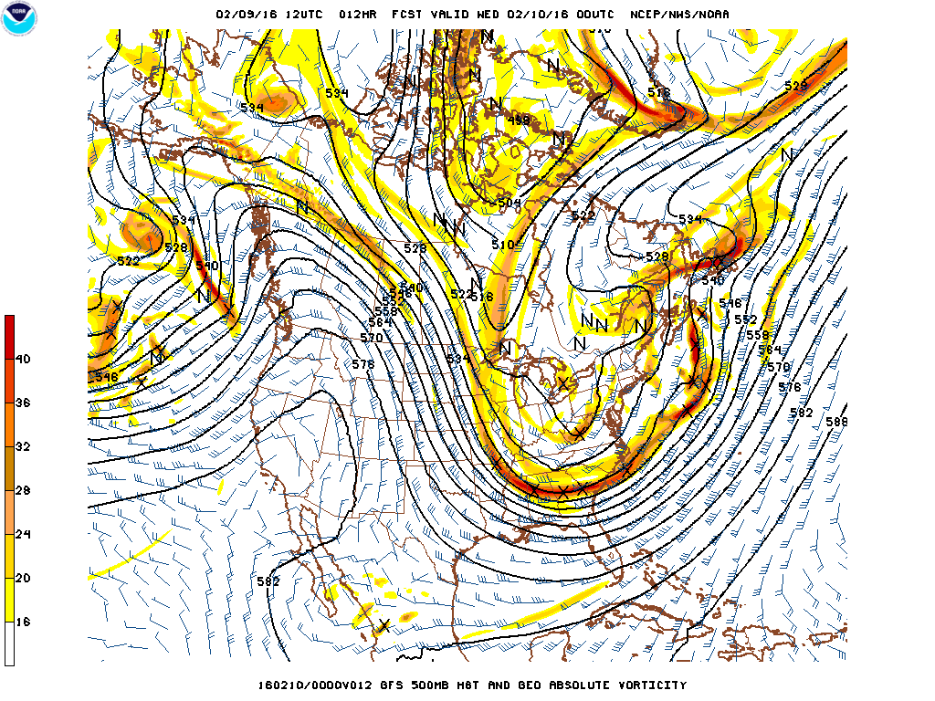
12 h forecast

Slide 7
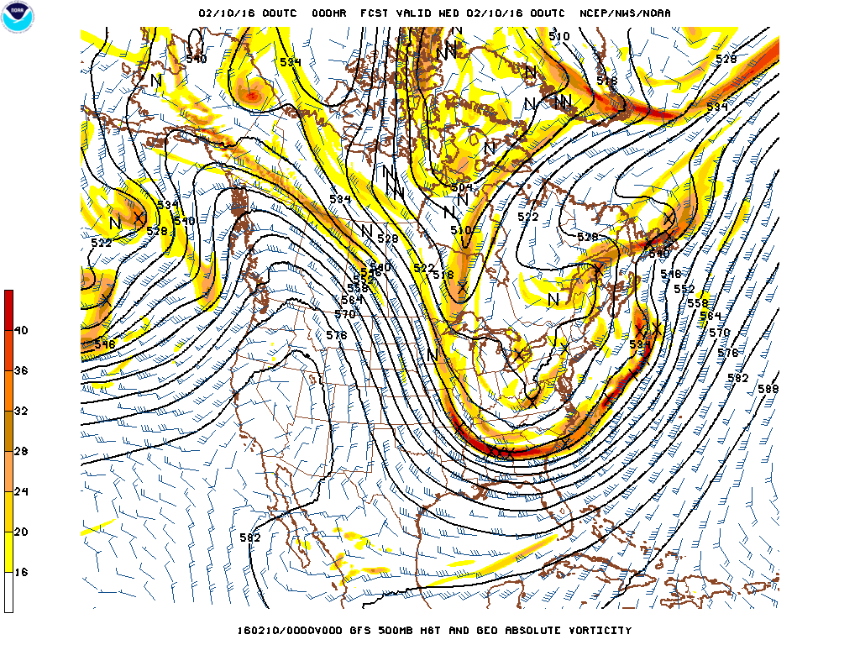
Analysis

Slide 8
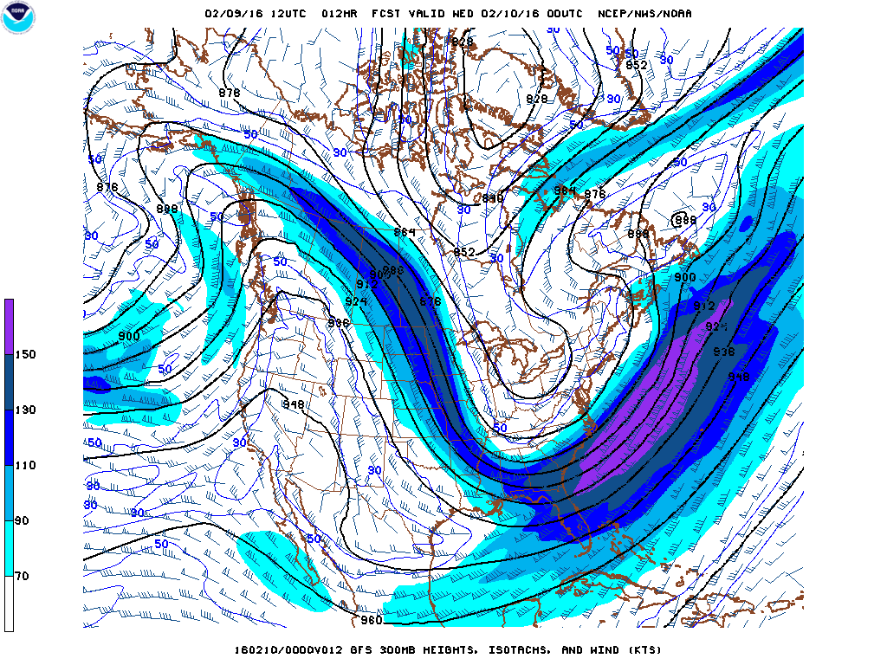
12 h forecast

Slide 9
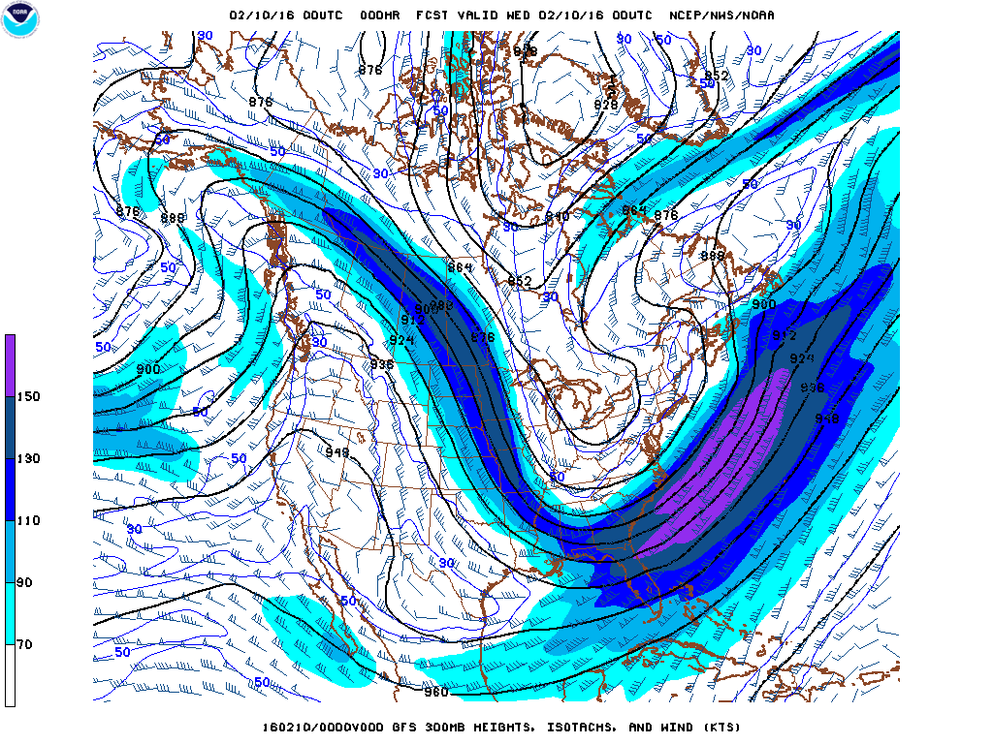
Analysis

Slide 10
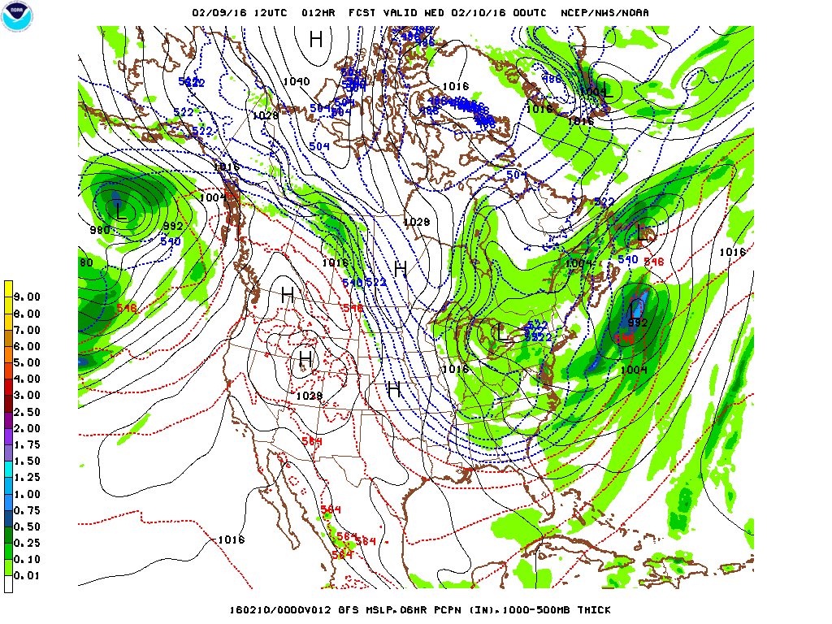
12 h forecast

Slide 11
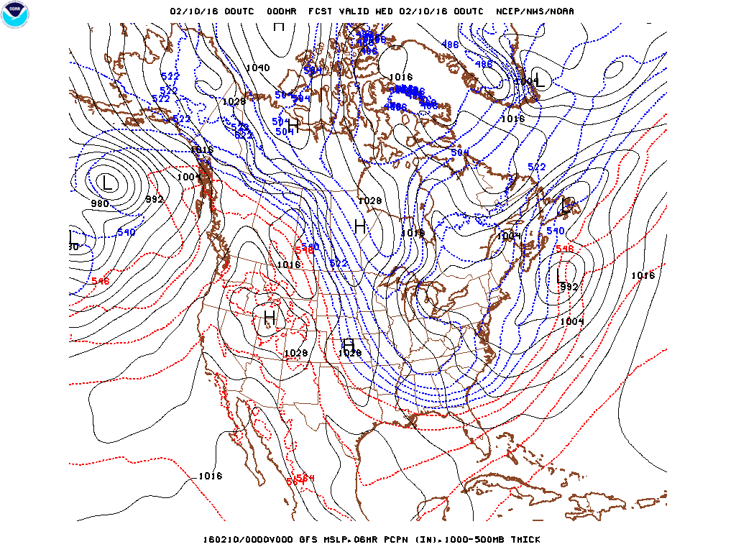
Analysis

Slide 12
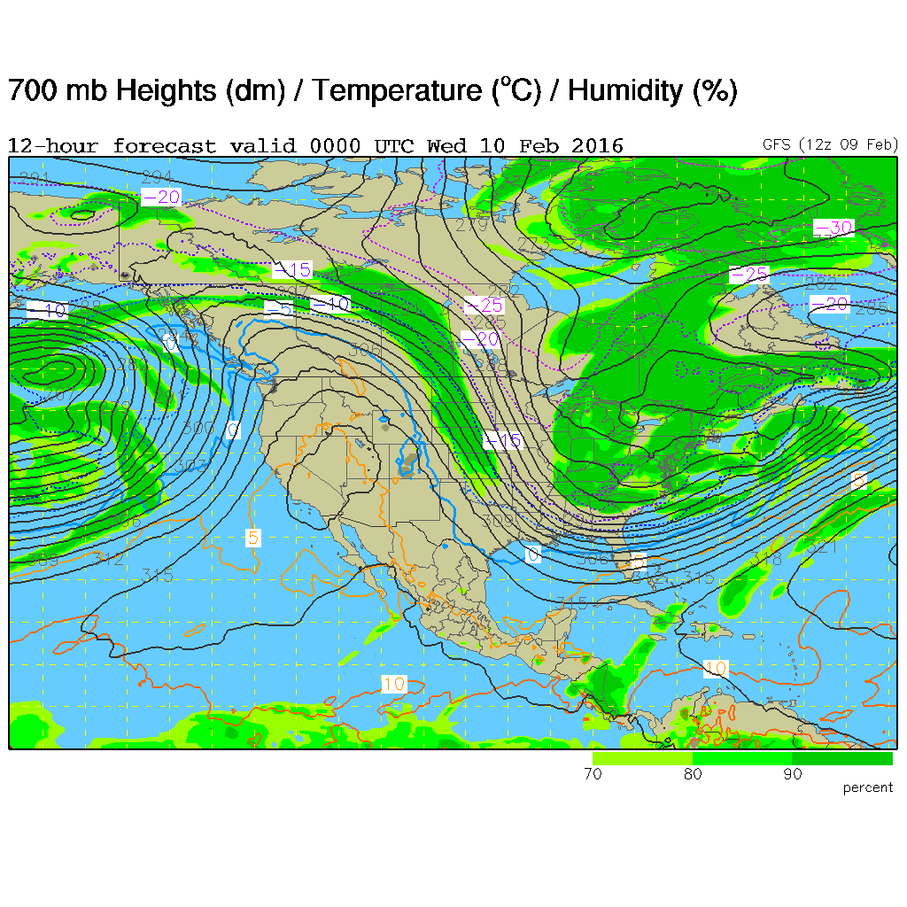
12 h forecast

Slide 13
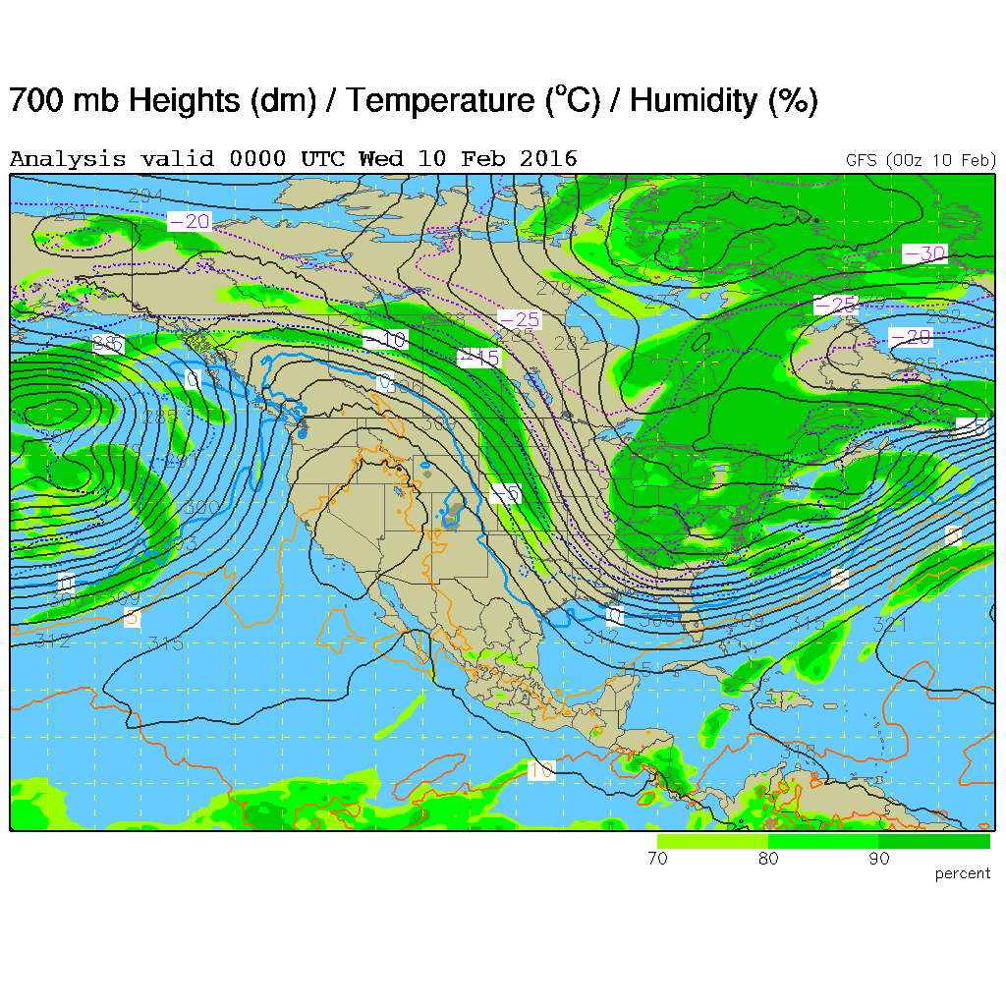
Analysis

Slide 14
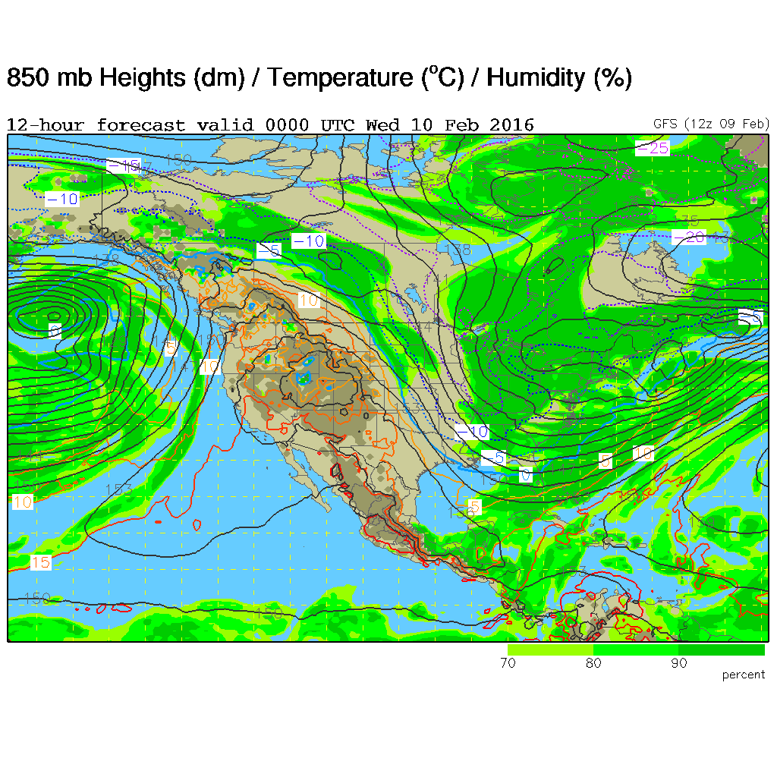
12 h forecast

Slide 15
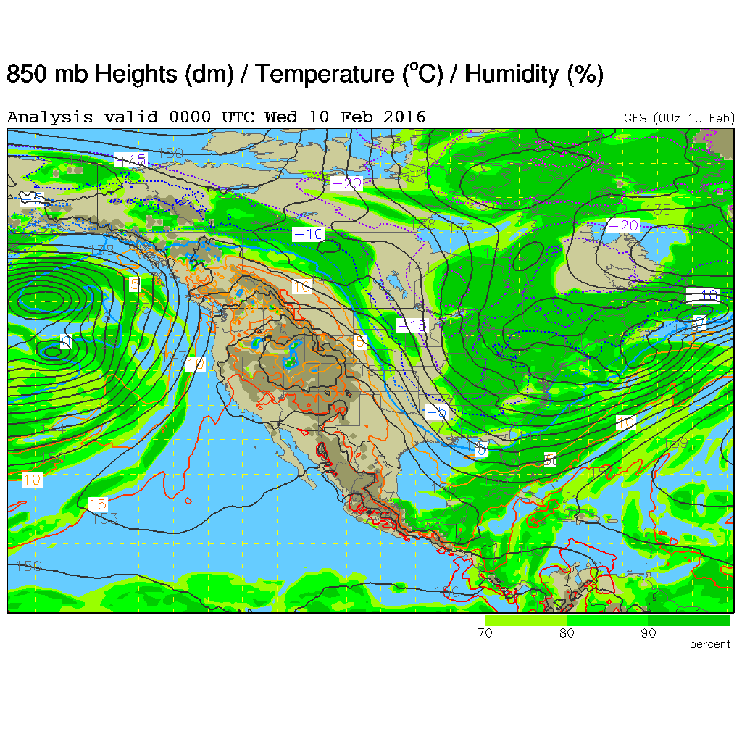
Analysis

Slide 16
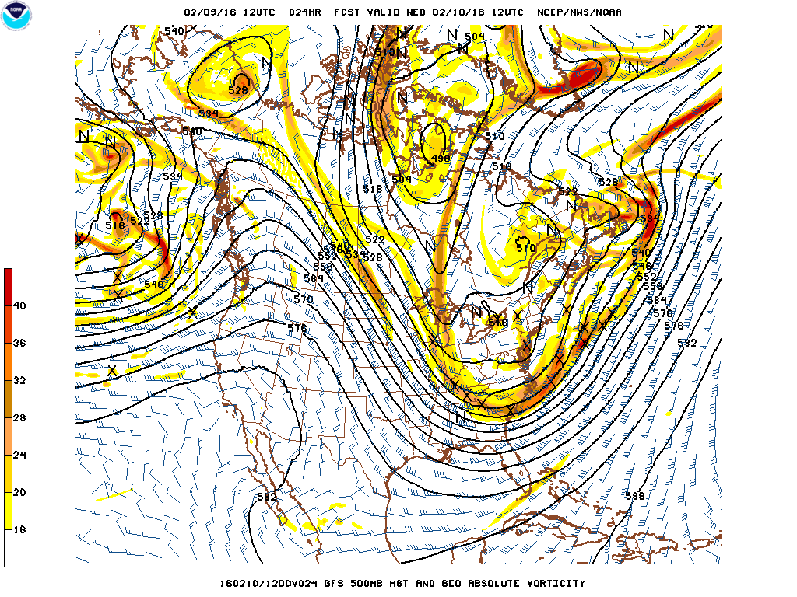
24 h forecast

Slide 17
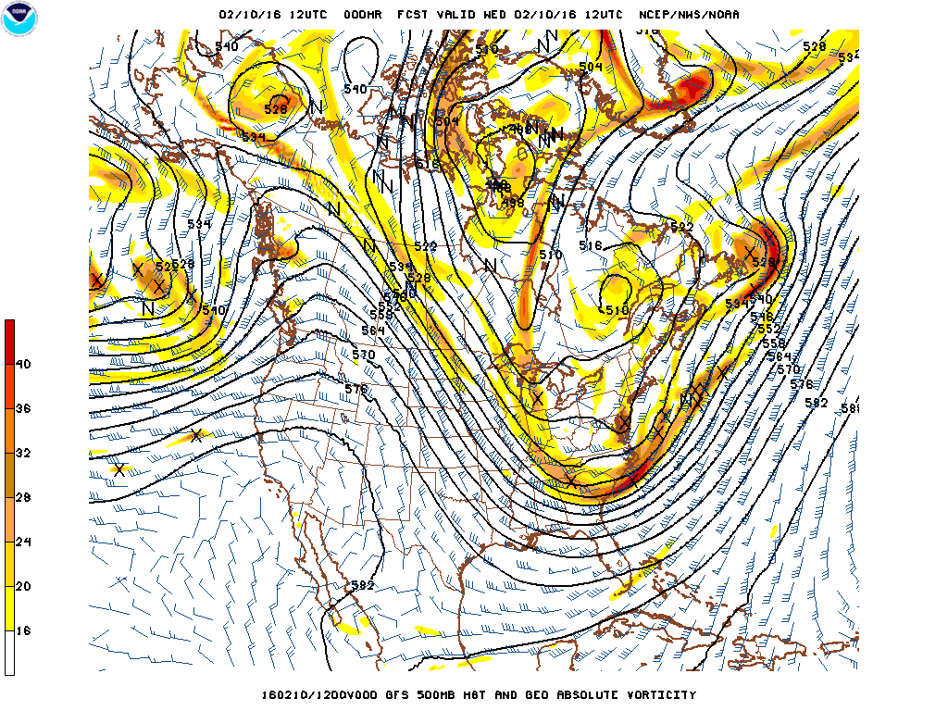
Analysis

Slide 18
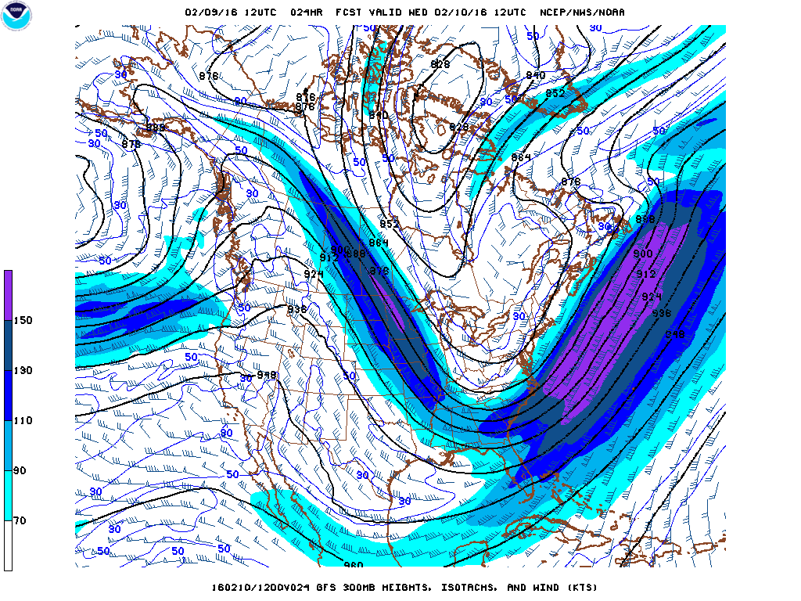
24 h forecast

Slide 19
Analysis

Slide 20
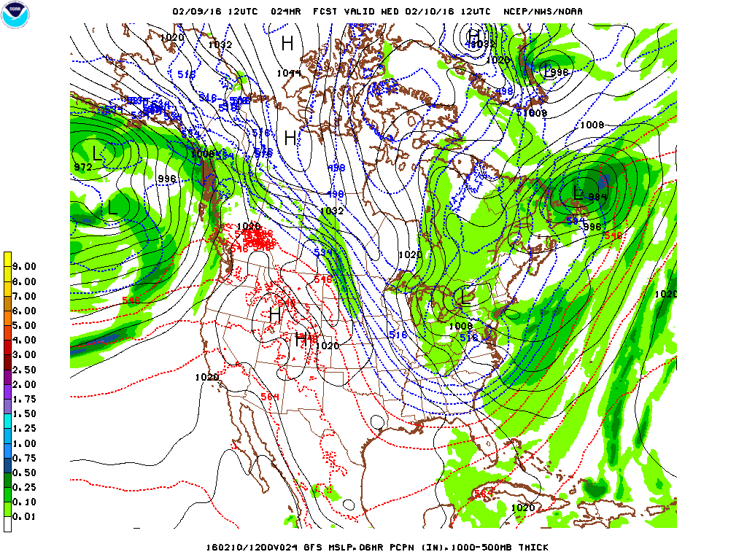
24 h forecast

Slide 21
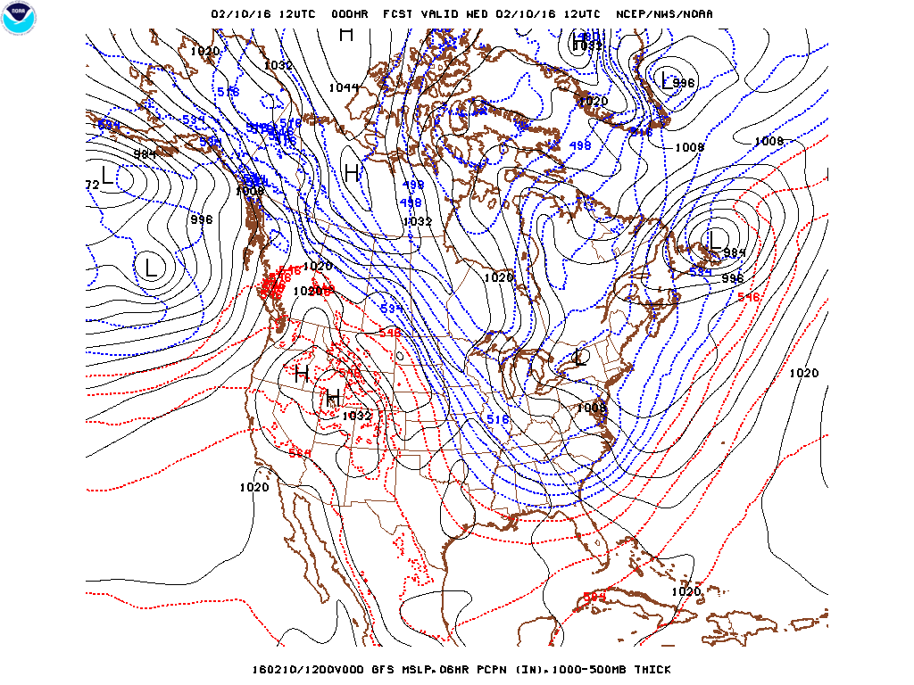
Analysis

Slide 22
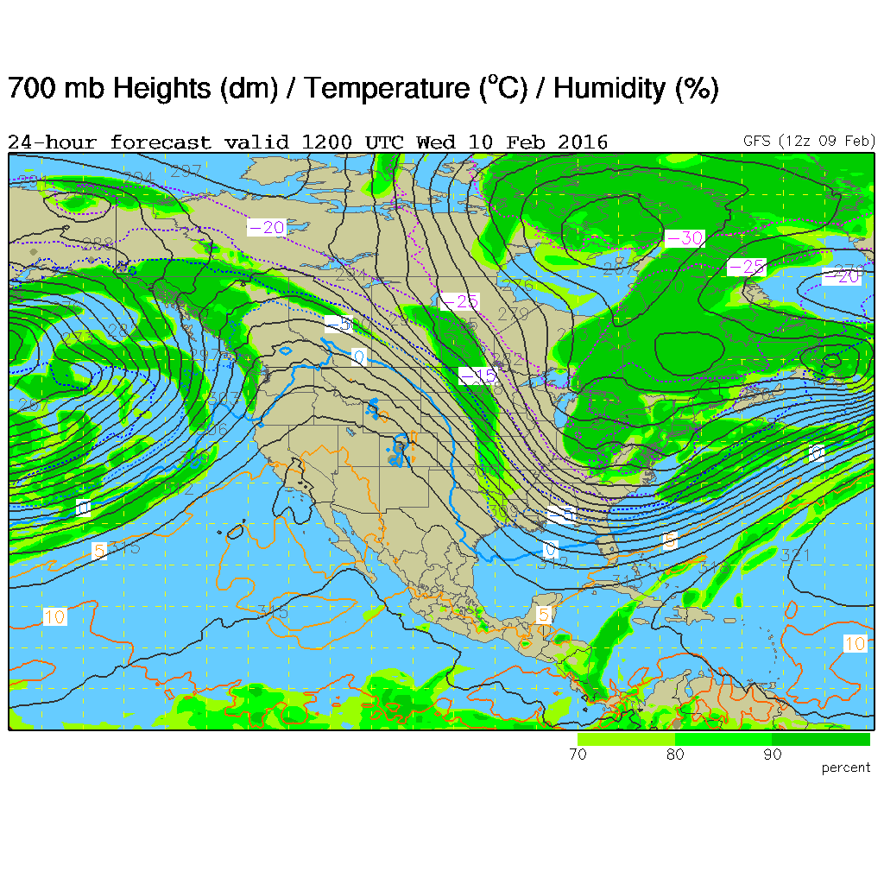
24 h forecast

Slide 23
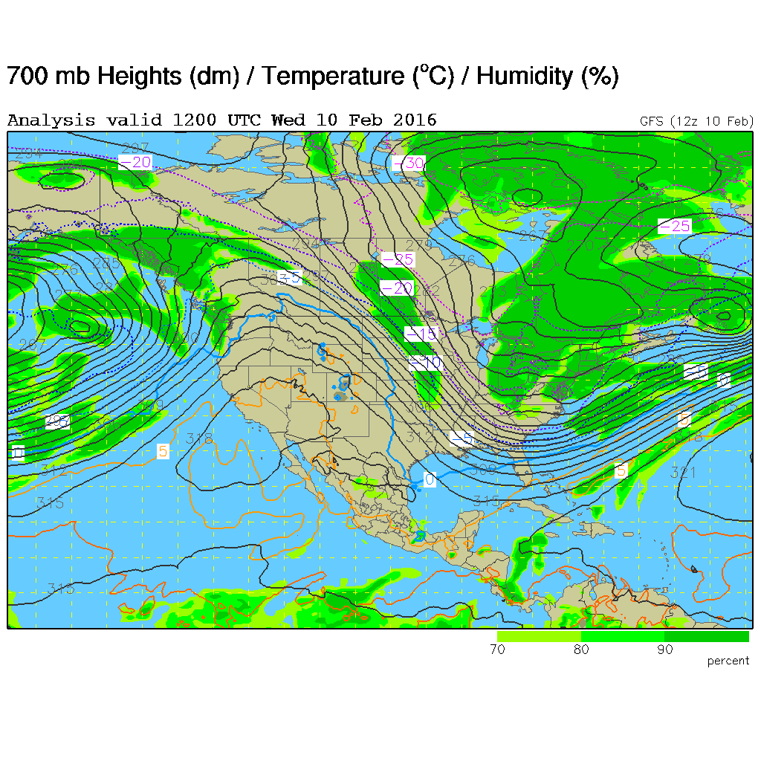
Analysis

Slide 24
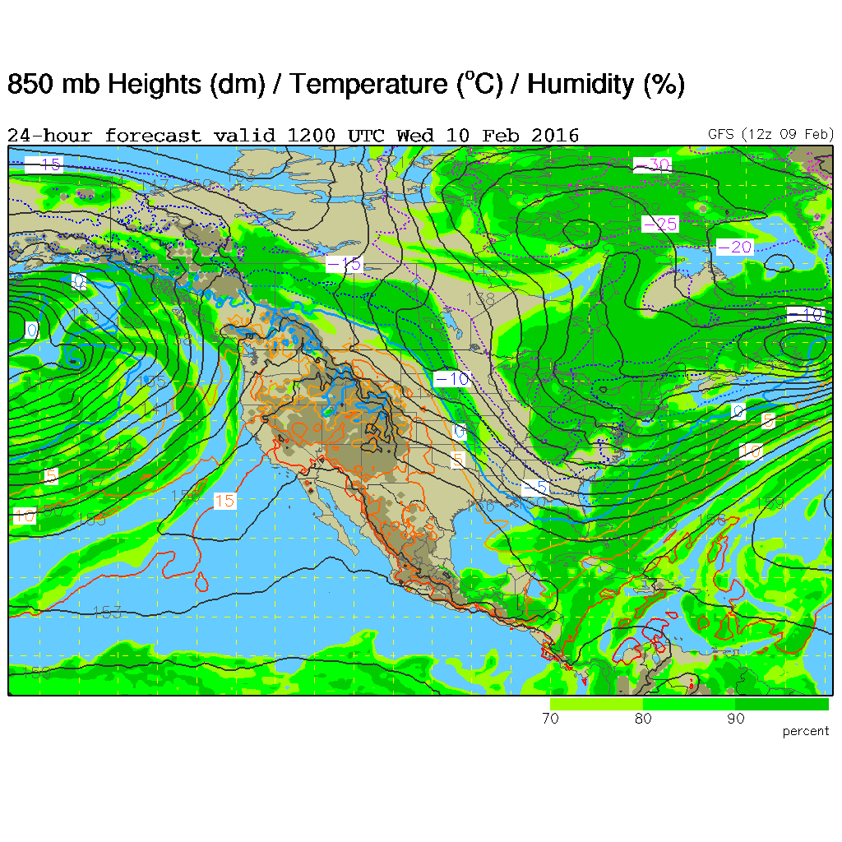
24 h forecast

Slide 25
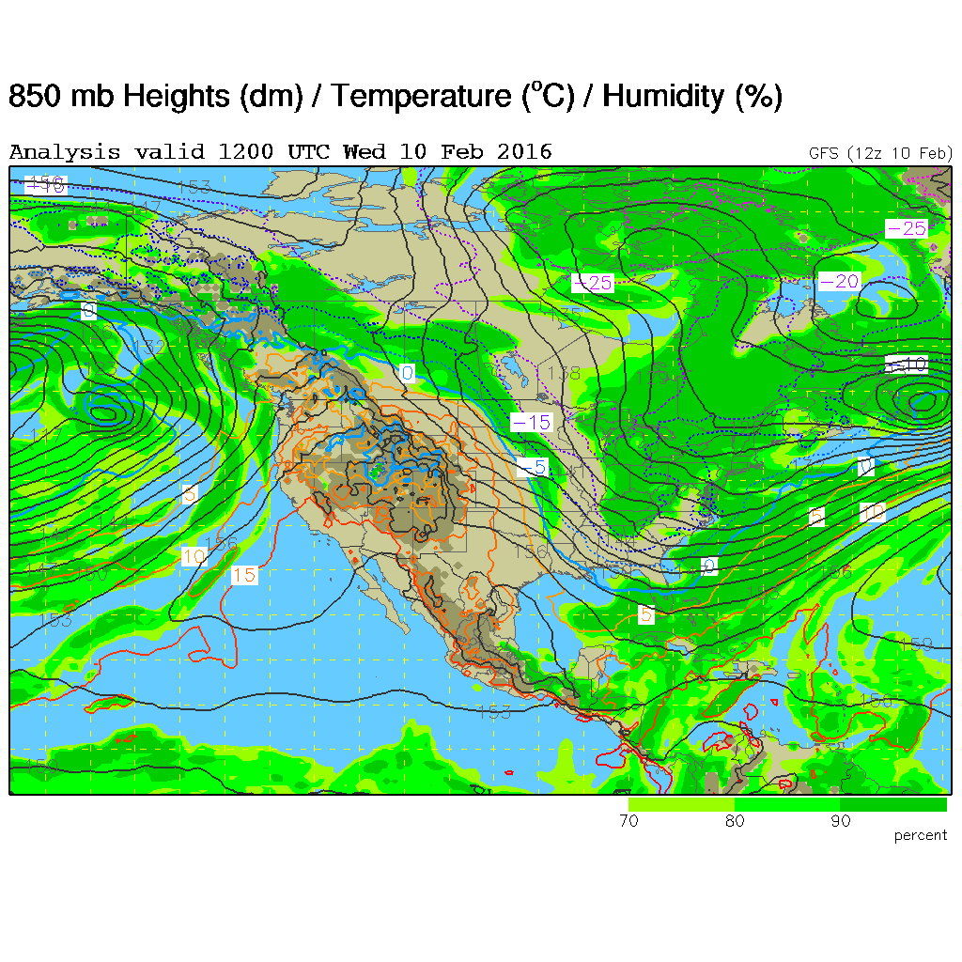
Analysis

Slide 26
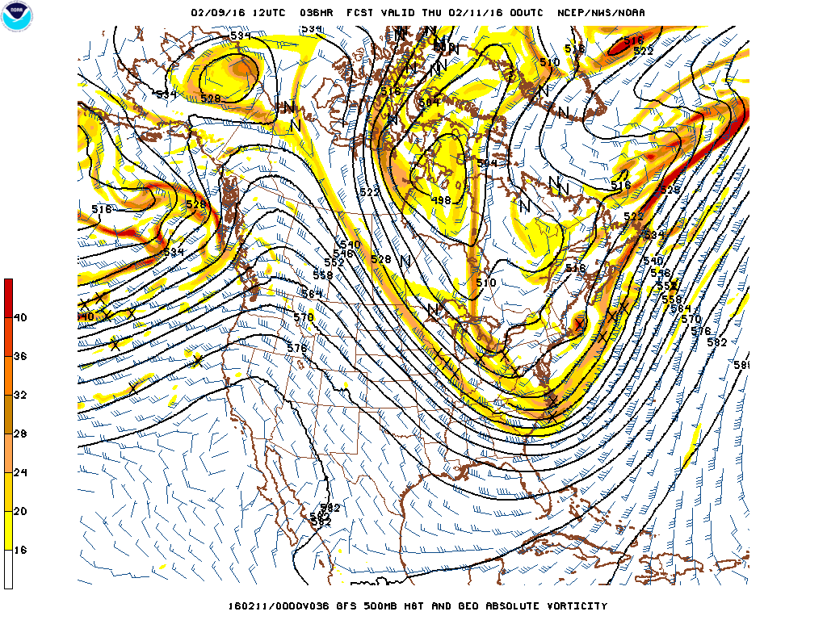
36 h forecast

Slide 27
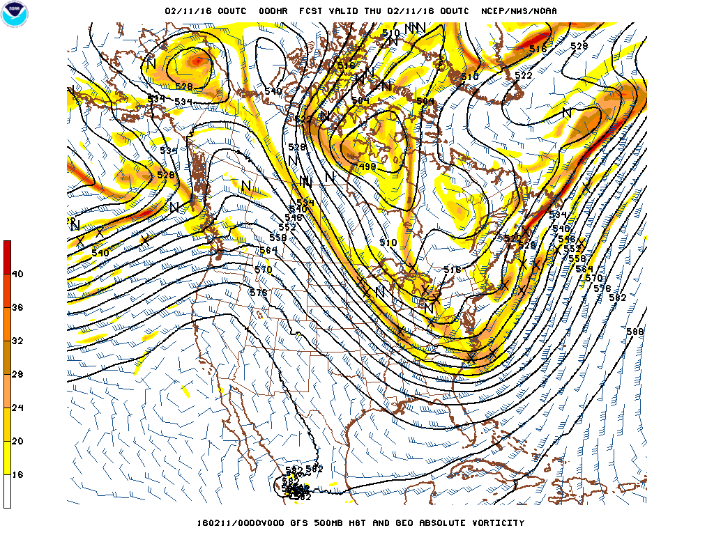
Analysis

Slide 28
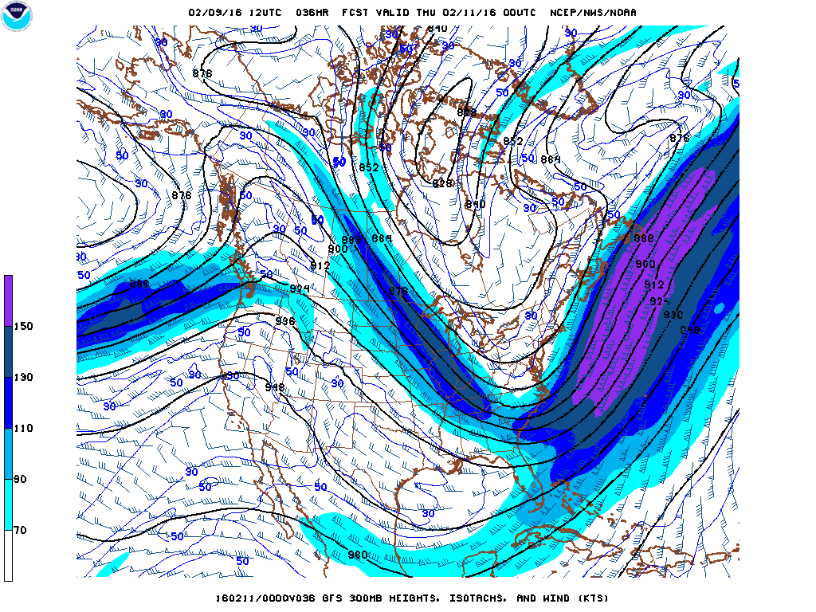
36 h forecast

Slide 29
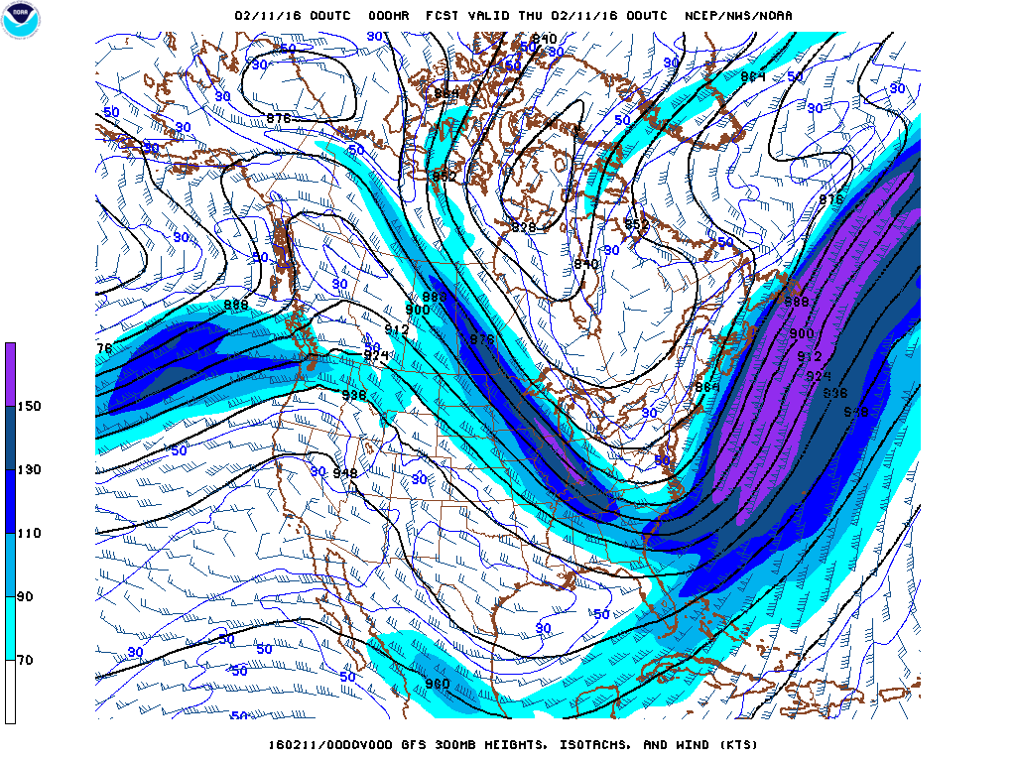
Analysis

Slide 30
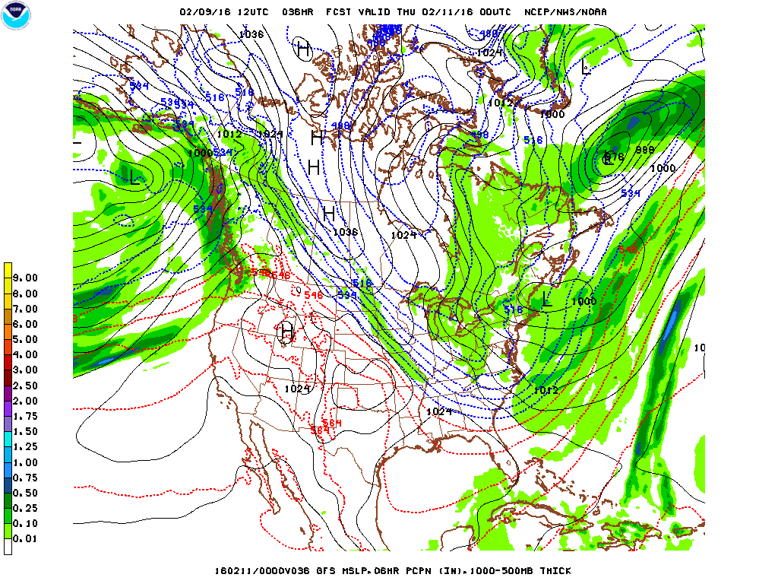
36 h forecast

Slide 31
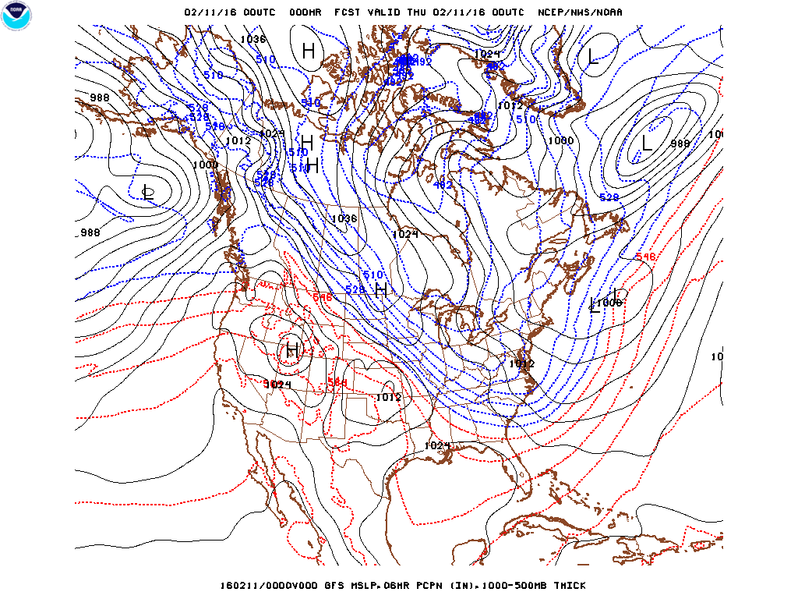
Analysis

Slide 32
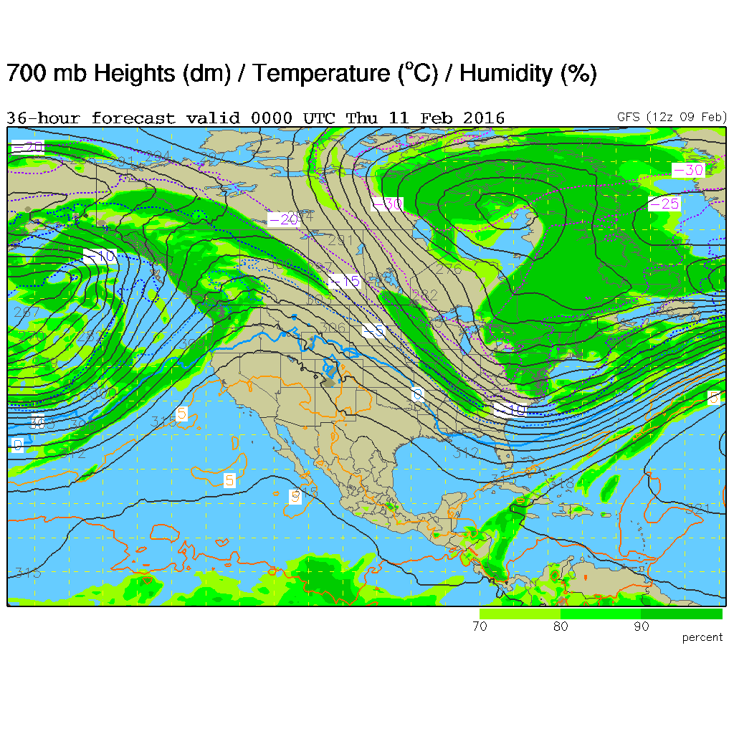
36 h forecast

Slide 33
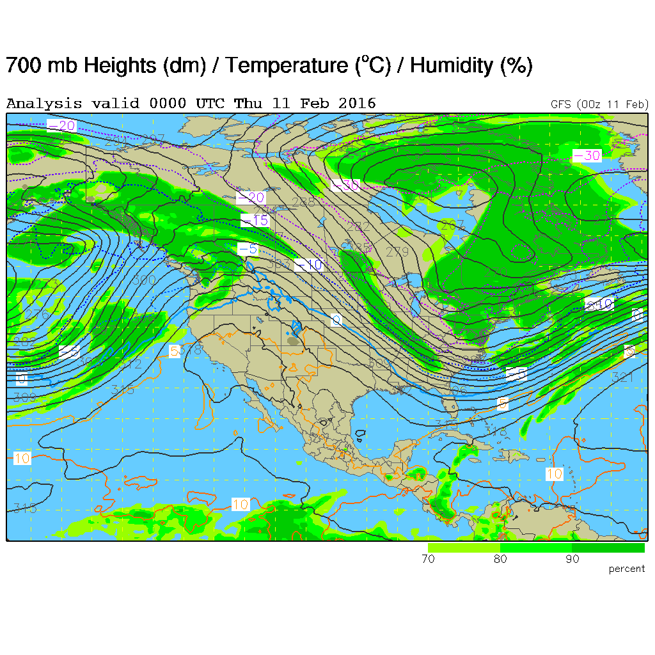
Analysis

Slide 34
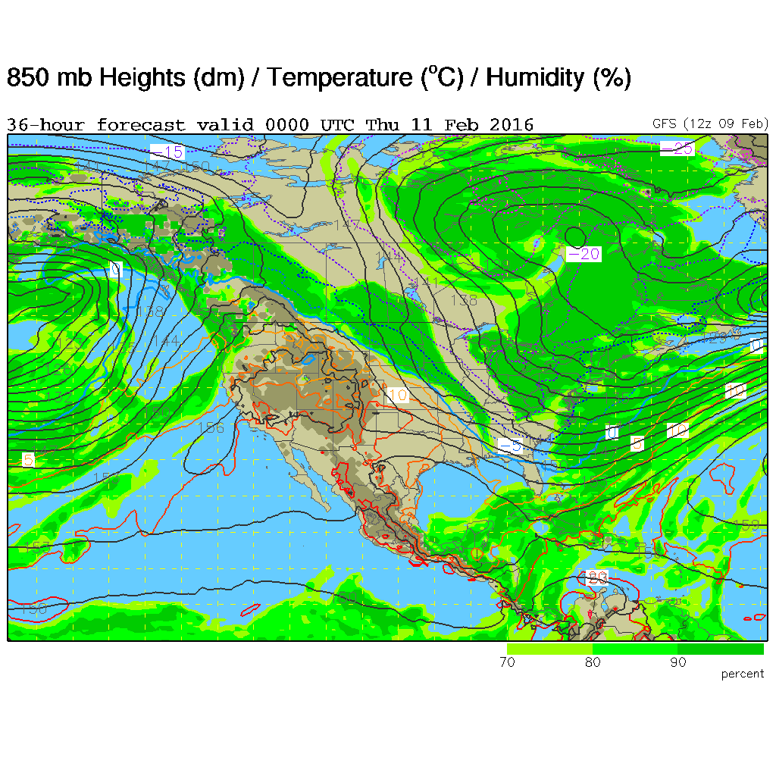
36 h forecast

Slide 35
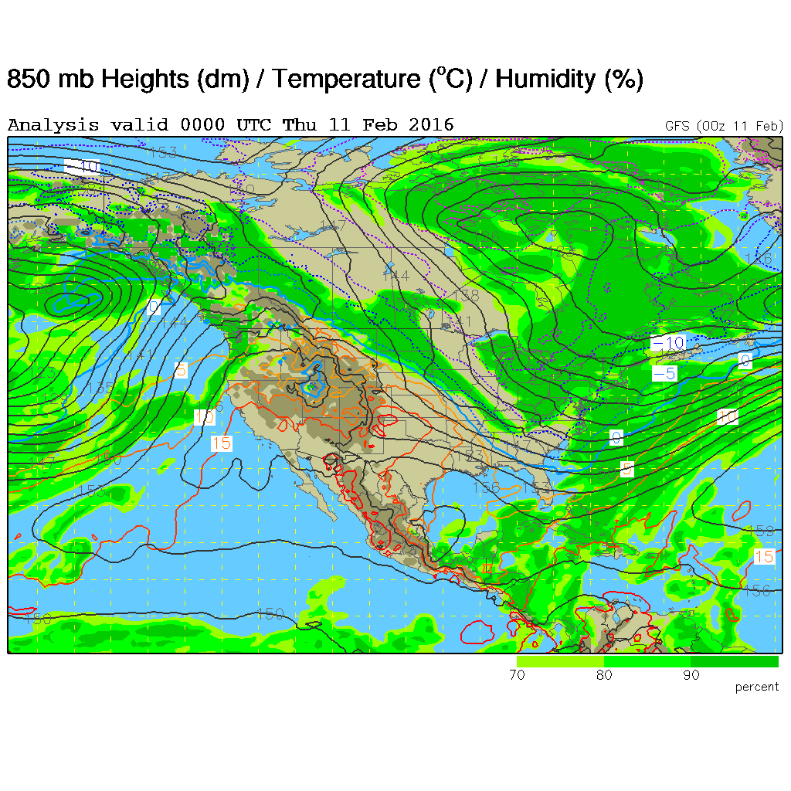
Analysis

Slide 36
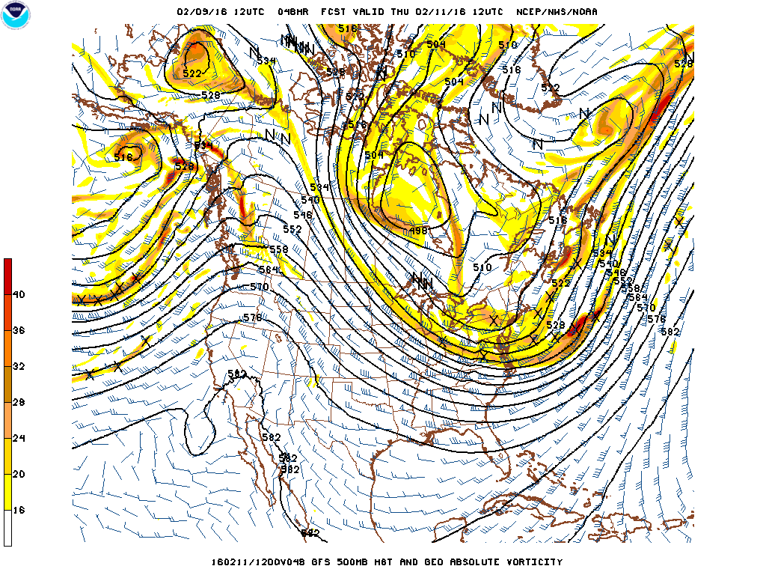
48 h forecast

Slide 37
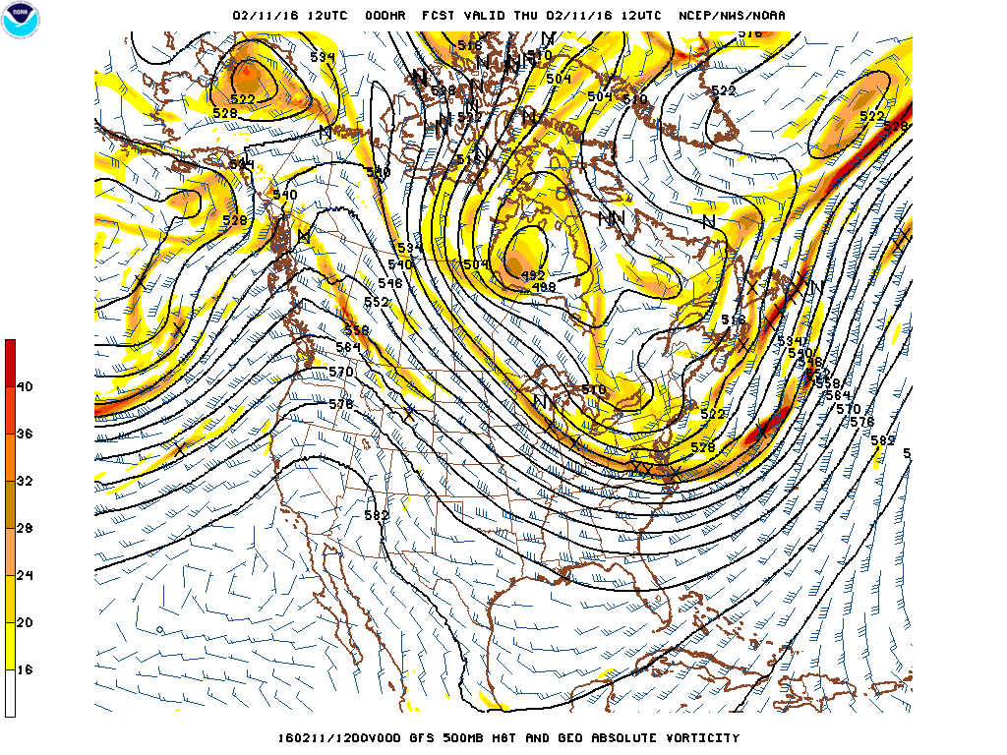
Analysis

Slide 38
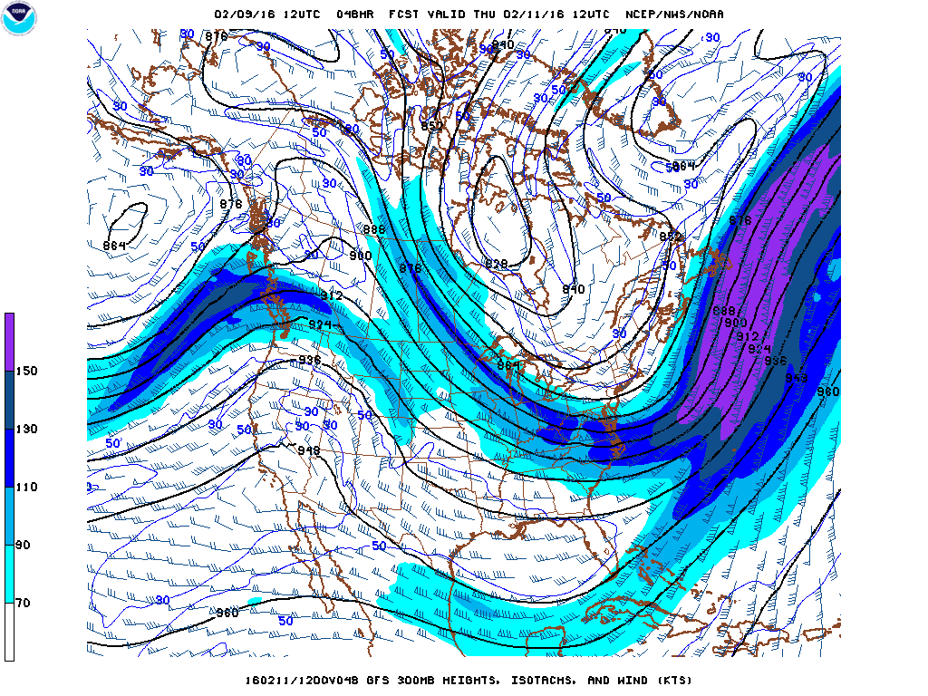
48 h forecast

Slide 39
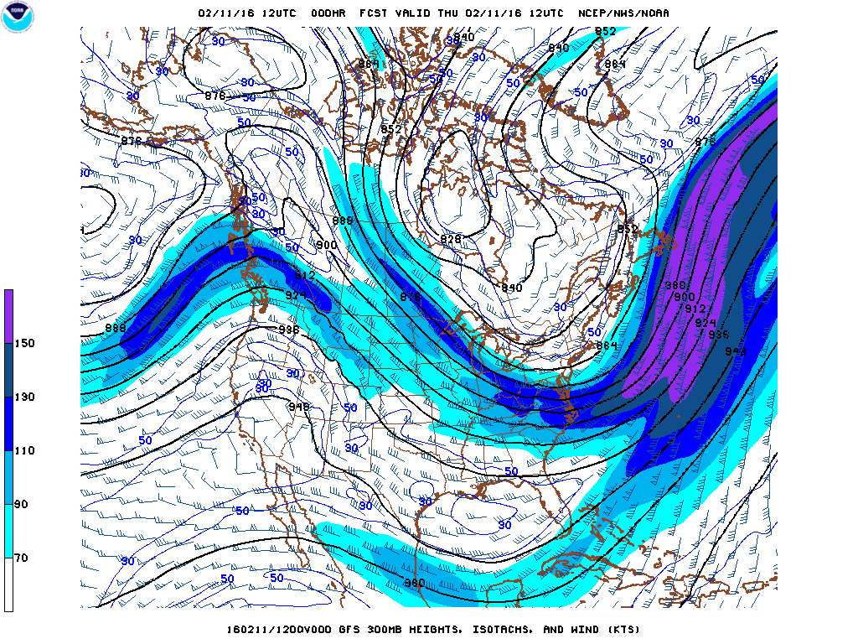
Analysis

Slide 40
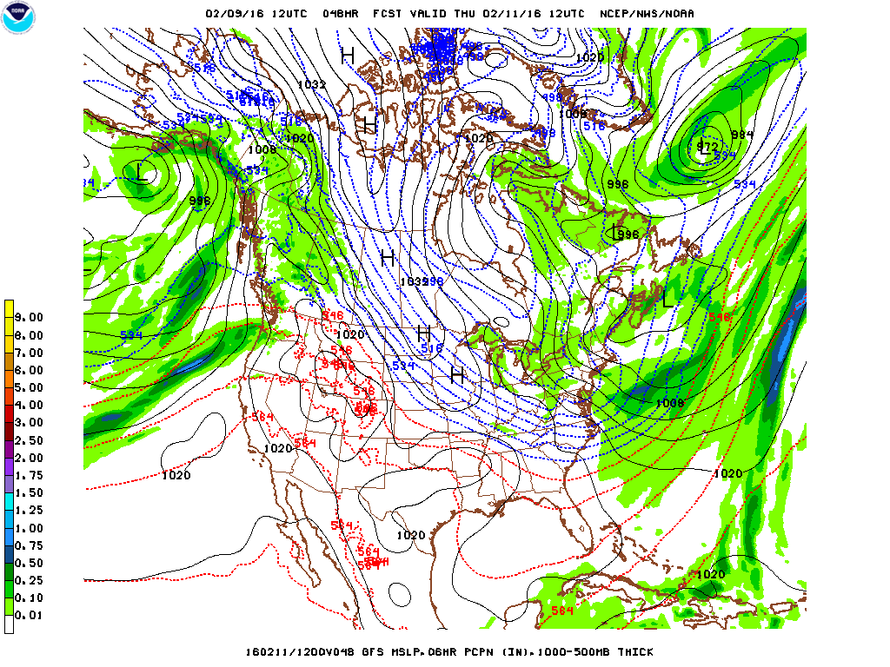
48 h forecast

Slide 41
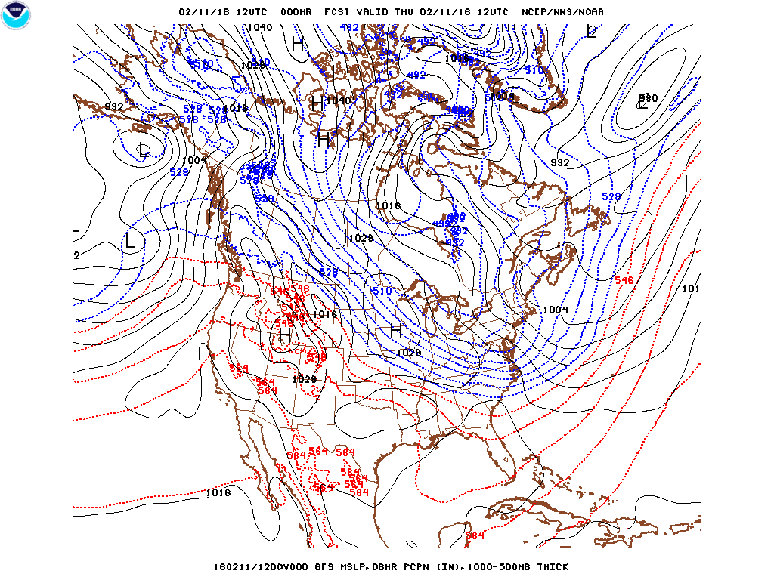
Analysis

Slide 42
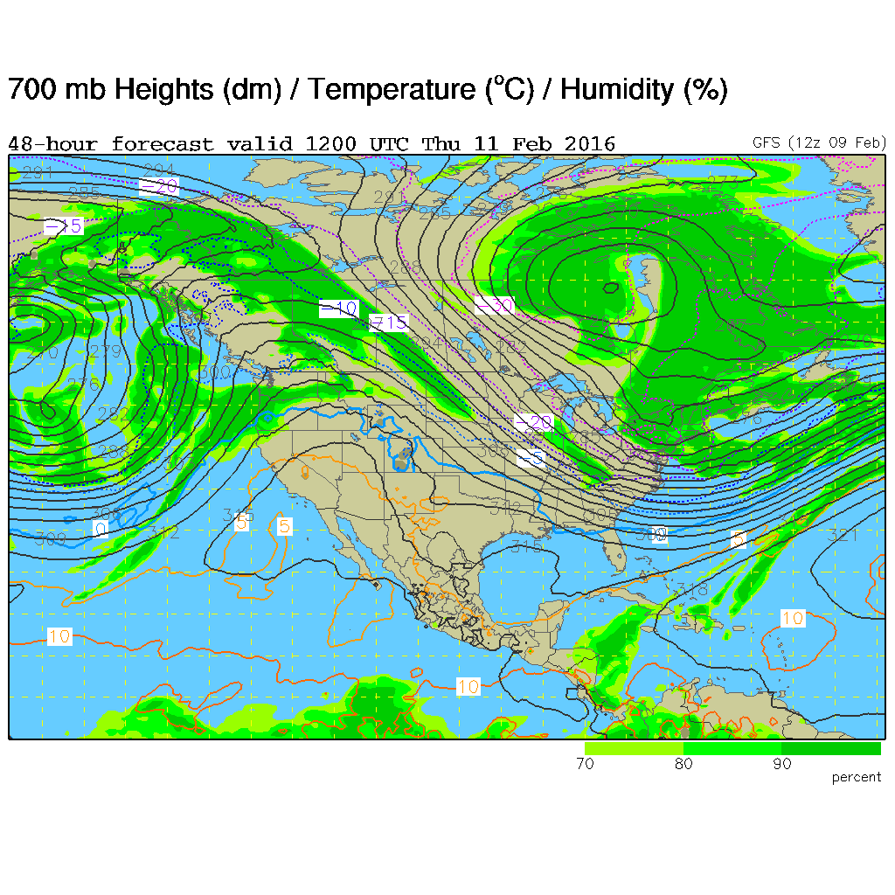
48 h forecast

Slide 43
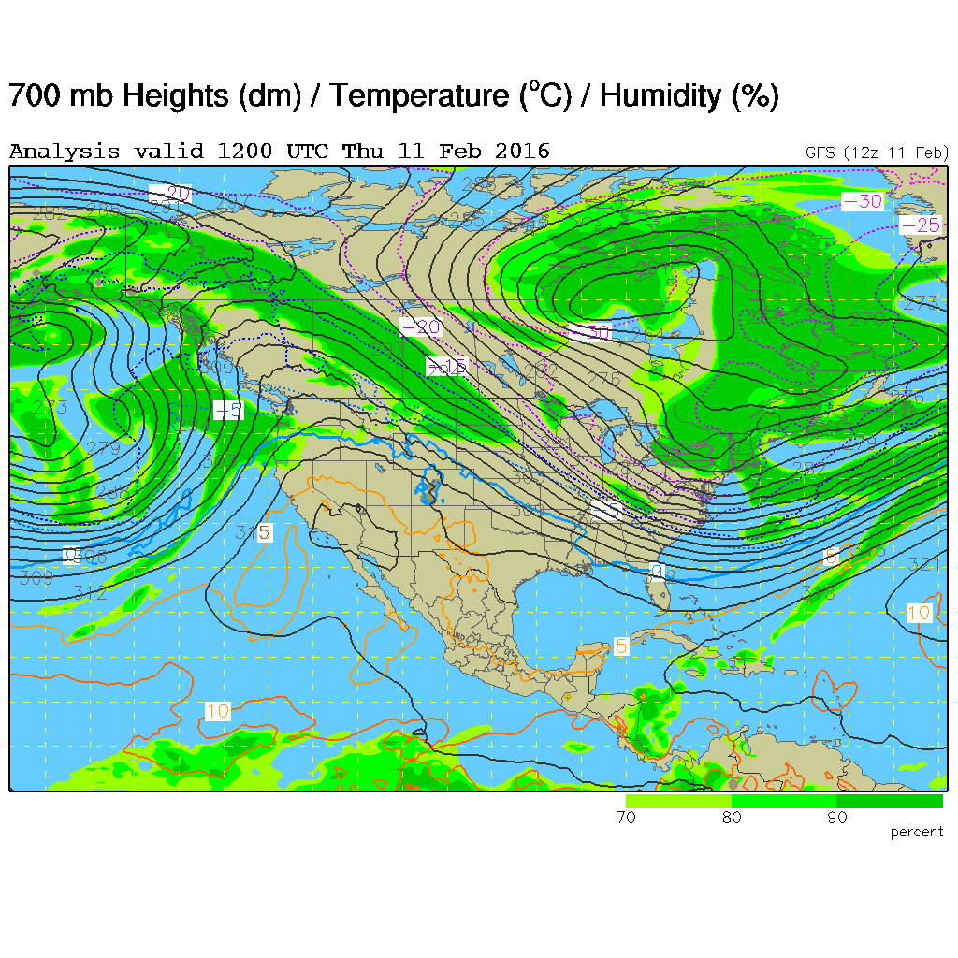
Analysis

Slide 44
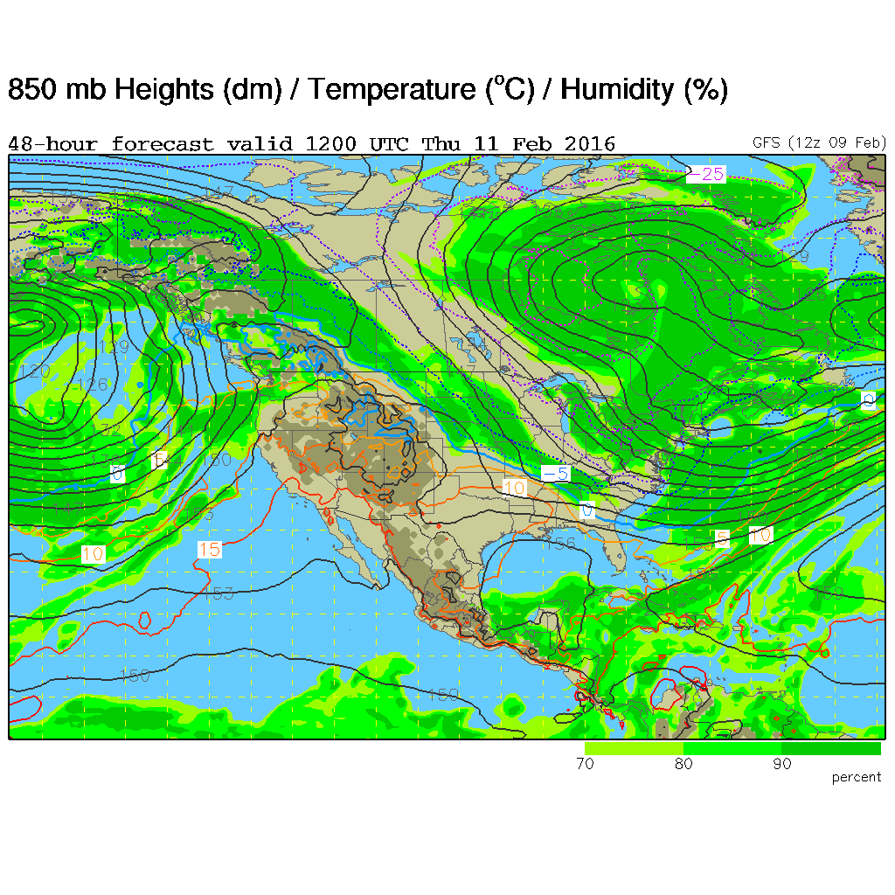
48 h forecast

Slide 45
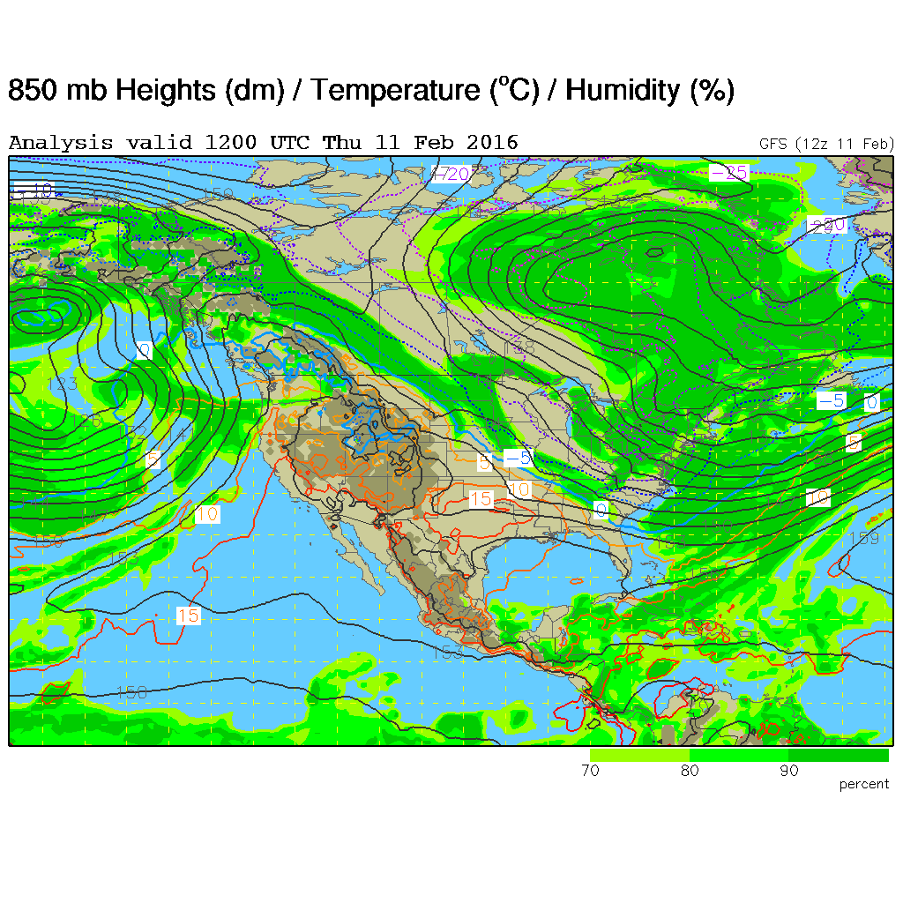
Analysis

Slide 46
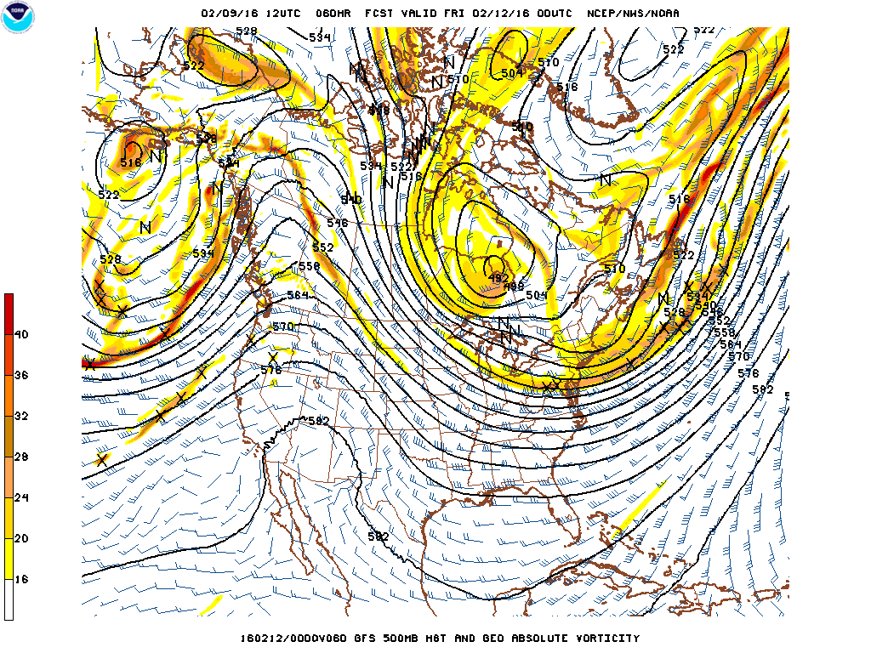
60 h forecast

Slide 47
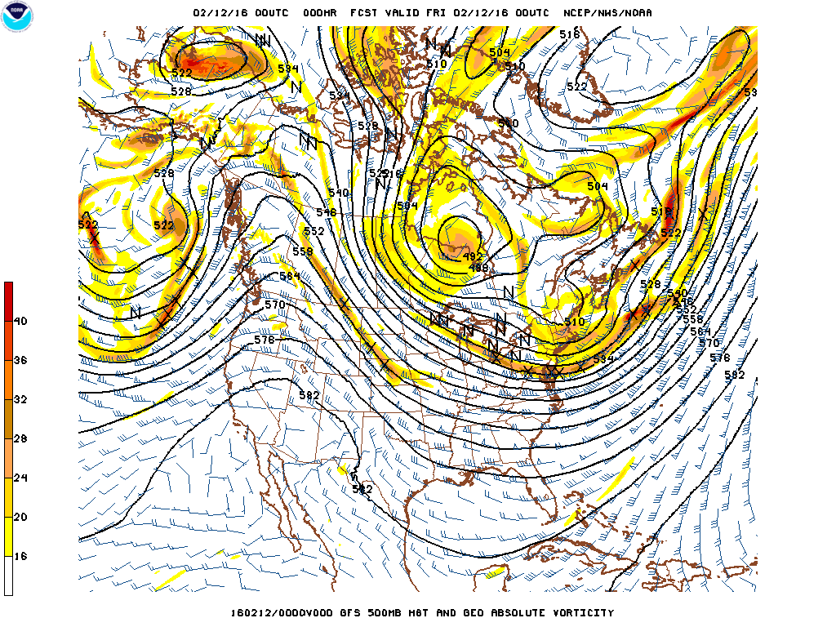
Analysis

Slide 48
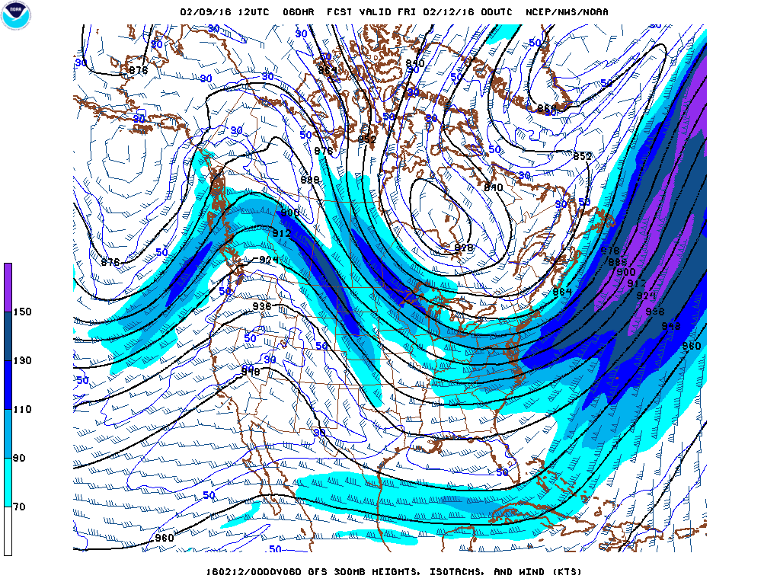
60 h forecast

Slide 49
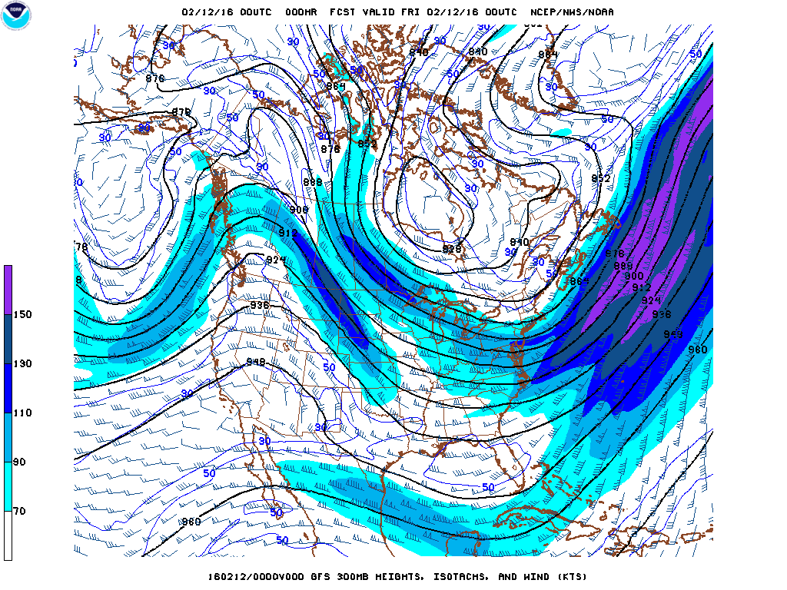
Analysis

Slide 50
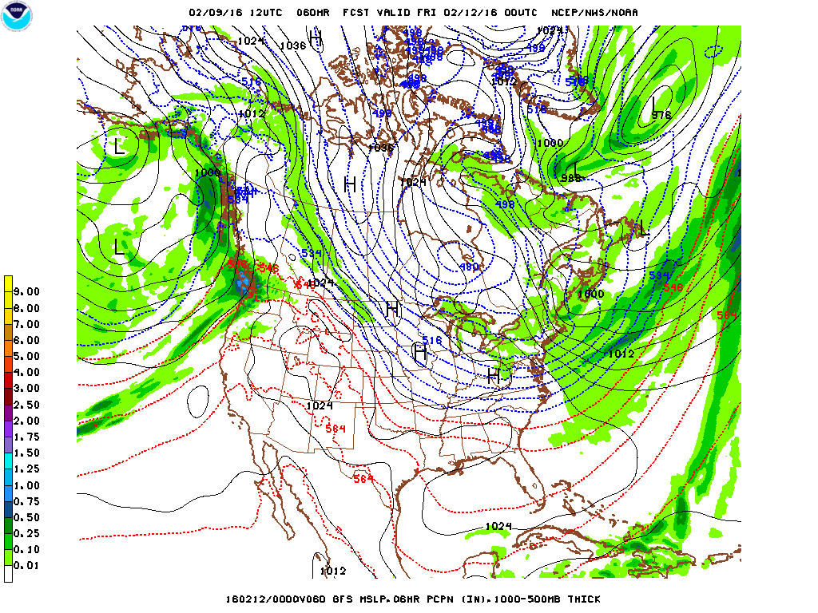
60 h forecast

Slide 51
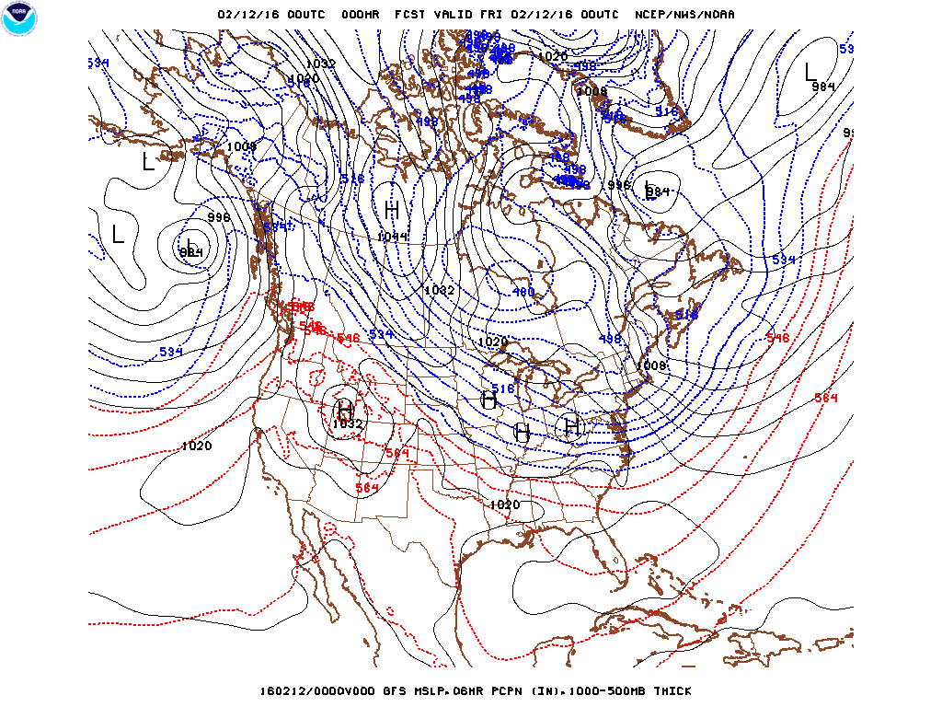
Analysis

Slide 52
60 h forecast

Slide 53
Analysis

Slide 54
60 h forecast

Slide 55
Analysis

Slide 56
72 h forecast

Slide 57
Analysis

Slide 58
72 h forecast

Slide 59
Analysis

Slide 60
72 h forecast

Slide 61
Analysis

Slide 62
72 h forecast

Slide 63
Analysis
Not Available

Slide 64
72 h forecast

Slide 65
Analysis
Not Available

Slide 66
Denver Wednesday

Slide 67
Denver Thursday

Slide 68
Denver
Tuesday PM to Wednesday AM

Slide 69
Denver Wednesday AM to Wednesday PM

Slide 70
Denver Wednesday PM to Thursday AM

Slide 71
Denver Thursday AM to Thursday PM

Slide 72
Denver Thursday PM to Friday AM

Slide 73
Chicago Wednesday

Slide 74
Chicago Thursday

Slide 75
Chicago
Tuesday PM to Wednesday AM

Slide 76
Chicago Wednesday AM to Wednesday PM

Slide 77
Chicago
Wednesday PM to Thursday AM

Slide 78
Chicago
Thursday AM to Thursday PM

Slide 79
Chicago
Thursday PM to Friday AM

