Slide 1
Renewable Energy for Vulnerable Populations:
A Case Study on Hydropower in the Himalayas
By Meaghan Cunniffe

Slide 2
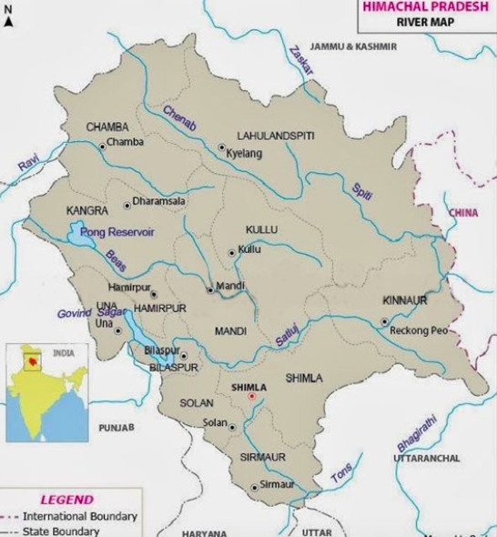
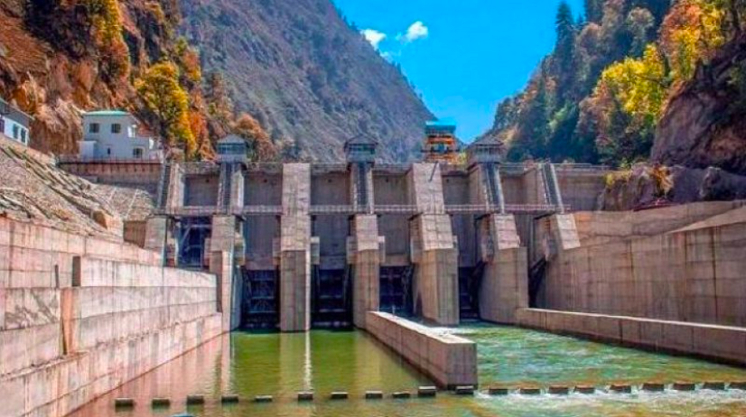
Why Renewables?
The Great Power Outage of 2012
700 million lost power
There are still 200 million who lack access to power
India still relies on imports to meet energy demand
There is a push to move toward renewable energy production
India joined the Paris Agreement in 2016
India accounts for ~7% of global CO2 emissions
Air pollution in India has been a health issue

Slide 3
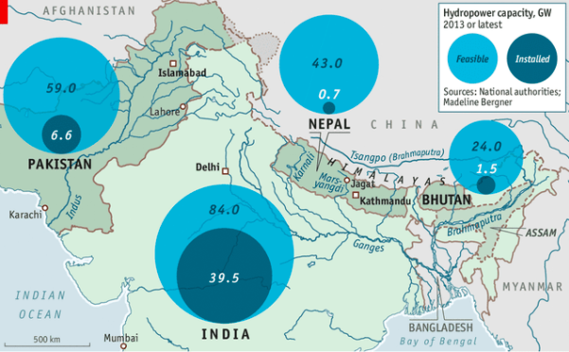
Renewables in India and the Paris Agreement
They are meeting an even currently ahead on some of their goals
Renewable capacity has increases by 226% in the past five years
India is currently producing 89 GW of renewable energy
Their target is 450 GW from renewables by 2030

Slide 4
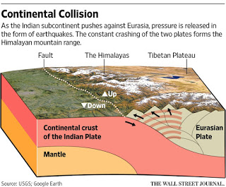
Himalayan Terrain and Climate Change
As climate change intensifies, so will the likelihood of extreme events
The Himalayas are very prone to earthquakes, landslides, and avalanches
Places like Himachal Pradesh, India suffer from drought
Monsoon Season
Western Himalayas (about 60 inches of rainfall)
Eastern Himalayas (120 inches of rainfall)
Areas suffering from drought are more prone to landslides and/or flooding
Hydropower Plant construction can remove important vegetation, which would otherwise mitigate the effects of landslides
Manipulation of the land = loss of biodiversity

Slide 5
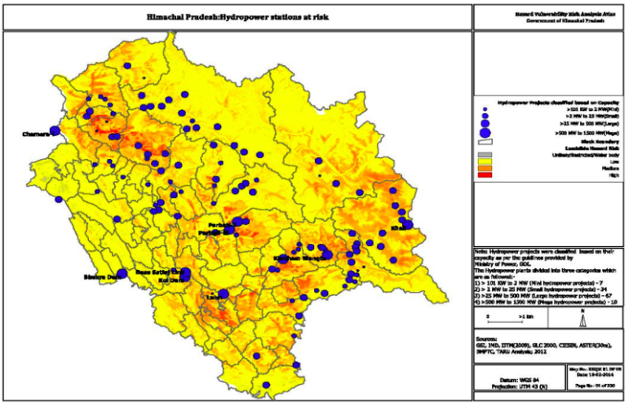
Location of hydropower dams relative to landslide hazard risk in Himachal Pradesh. The increasing dot sizes (which represent where dams are located) correspond with increasing power generation (MW).

Slide 6
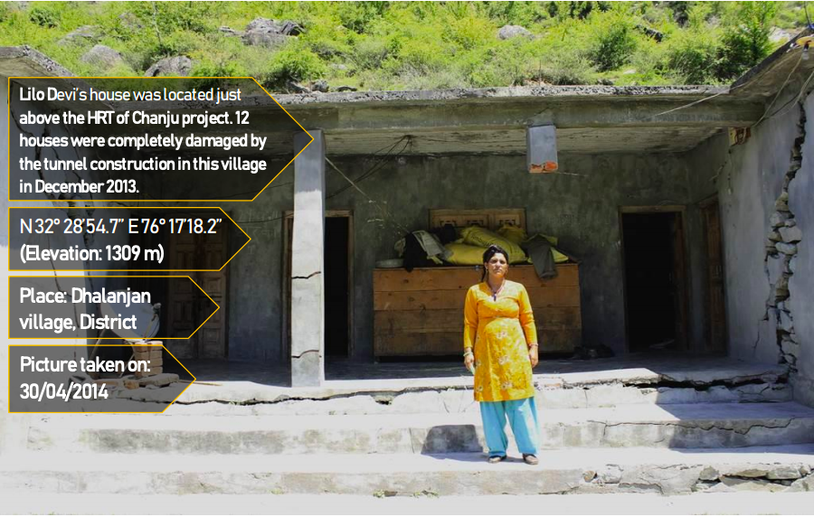

Slide 7
Government and Policy - How a Plan is Developed
First, the plans must be written in the form of a preliminary feasibility (PFR) report.
Must pass through eight governmental departments and receive a “no objectification certificate.”
1st department is the local government: Panchayat Raj
Consists of 5 elected officials (also includes positions set aside for tribal leader)
Sometimes corruption can happen if leaders accept bribes from energy companies
If it is fully approved, the PFR must be rewritten as a detailed project report.
Then a formal agreement is reached regarding project plans and goals
This is followed by a techno-economic (engineering and economic component) assessment
After this the project can begin!

Slide 8
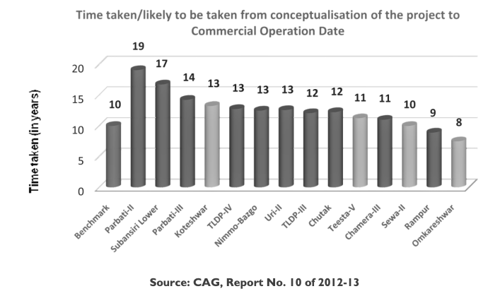
Why HP Projects May Be Slow
Construction challenges
Accidents involving workers
Protests from locals
Natural Catastrophes and Geological Hazards
Funding
Why Projects May Be Ineffective
Poor planning
Lack of knowledge about the terrain and rivers
Unsuccessful reforestation plans
People may be relocated without consent
Local do not have enough knowledge about Hydropower

Slide 10
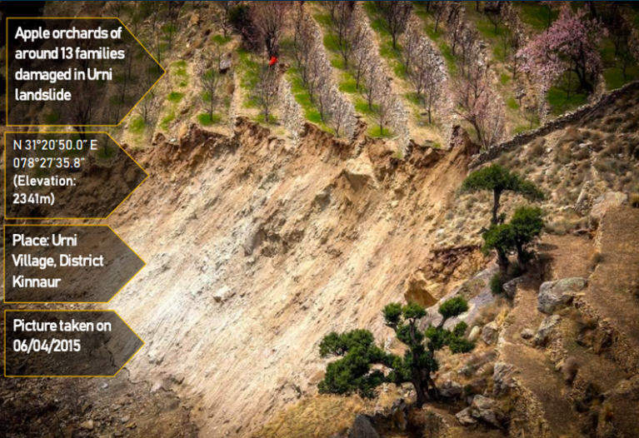

Slide 11
Discussion: Your Initial thoughts
What are the pros and cons of hydropower in the Himalayas?
Do you know any other examples of how vulnerable populations are affected by climate change or its mitigation efforts?
Is this partly an issue with the Paris Agreement?
How can we change it to fit the needs of vulnerable groups?

Slide 12
And now we’ll watch a short video about the Parbati II Hydropower Project:
https://www.youtube.com/watch?v=E7apDkM5Cnc

Slide 13
Now let’s break into groups and do some role-play!
Group 1: Local Residents (3 people)
Group 2: Scientists and Researchers (2 people)
Group 3: Indian Government (3 people)
Group 4: Energy Companies (2 people)
https://docs.google.com/document/d/1FLOOPwhe7Wm-iyLwRJnLooSpZ_EmyZYeS2H1LjTWcuA/edit?usp=sharing

Slide 14
Questions for Discussion:
What policies should be created to ensure more successful HP projects?
Should we keep developing hydropower in the Himalayas?
In your own opinion: How can we provide sustainable energy to vulnerable populations while ensuring we don’t take advantage of them?

Slide 15
Sources Cited:
5 years on, where India stands in its commitment to Paris Agreement. (2020, December 12). Hindustan Times. https://www.hindustantimes.com/india-news/5-years-on-where-india-stands-in-its-commitment-to-paris-agreement/story-M31plpICVbCP264U3q2h5L.html
Admin, P. A. (n.d.). Video: The #DirtyHydro Diaries: The Parbati Story: When mountains are hollowed – Himdhara. Retrieved April 12, 2021, from https://www.himdhara.org/2017/04/29/video-the-dirtyhydro-diaries-the-parbati-story-when-mountains-are-hollowed-2/
Chandel, V., & Brar, K. (2013). Drought in Himachal Pradesh, India: A historical-geographical perspective, 1901-2009. Transactions of the Institute of Indian Geographers, 35, 259–273.
Himalayan Cities and Towns. The Himalayas cover approximately 1,500… | by Rudra Shirodkar | Medium. (n.d.). Retrieved April 12, 2021, from https://medium.com/@Rudra31/himalayan-cities-and-towns-f65731c798e
Hydropower Construction: A Huge Risk for Himachal Pradesh. (n.d.). Retrieved April 13, 2021, from https://www.iamrenew.com/environment/hydropower-construction-a-huge-risk-for-himachal-pradesh/
India is increasingly dependent on imported fossil fuels as demand continues to rise—Today in Energy—U.S. Energy Information Administration (EIA). (n.d.). Retrieved April 12, 2021, from https://www.eia.gov/todayinenergy/detail.php?id=17551

Slide 16
Sources cited continued:
Ritchie, H., & Roser, M. (2020). CO₂ and Greenhouse Gas Emissions. Our World in Data. https://ourworldindata.org/co2/country/india
The Himalayas—Environmental problems—Avalanches. (n.d.). Retrieved April 12, 2021, from https://www.schoolnet.org.za/PILAfrica/en/webs/10131/proble_1.htm
The-Hidden-Cost-of-Hydropower_2019.pdf. (n.d.-a). Retrieved April 13, 2021, from http://www.himdhara.org/wp-content/uploads/2019/06/The-Hidden-Cost-of-Hydropower_2019.pdf
The-Hidden-Cost-of-Hydropower_2019.pdf. (n.d.-b). Retrieved April 13, 2021, from http://www.himdhara.org/wp-content/uploads/2019/06/The-Hidden-Cost-of-Hydropower_2019.pdf
Water in them hills. (2014, November 27). The Economist. https://www.economist.com/asia/2014/11/27/water-in-them-hills
Witspry. (n.d.). Why and How of the earthquake—Indian fault line. Articles by Witspry Technovate (Technovate.Witspry.Com). Retrieved April 12, 2021, from http://technovate.witspry.com/2017/02/why-and-how-of-earthquake-indian-fault.html?m=1

