Slide 1
Solar Power
By Brandon Klein

Slide 2
Kahoot

Slide 3
What is solar Energy?
Solar energy is capturing the energy from the sun and converting it into electricity

Slide 4
What are the main types of solar energy
-photovoltaic(PV)
-Concentrating Solar- thermal power (CSP)

Slide 5
Why is solar Energy important and why we need it?
Its energy is completely renewable (the sun)
It can be installed in anywhere someone sees fit (every square foot of roof or other space has the potential to generate about 15 watts of solar energy)
Notes:
Generally, every square foot of roof space has the potential to generate about 15 watts of solar energy

Slide 6
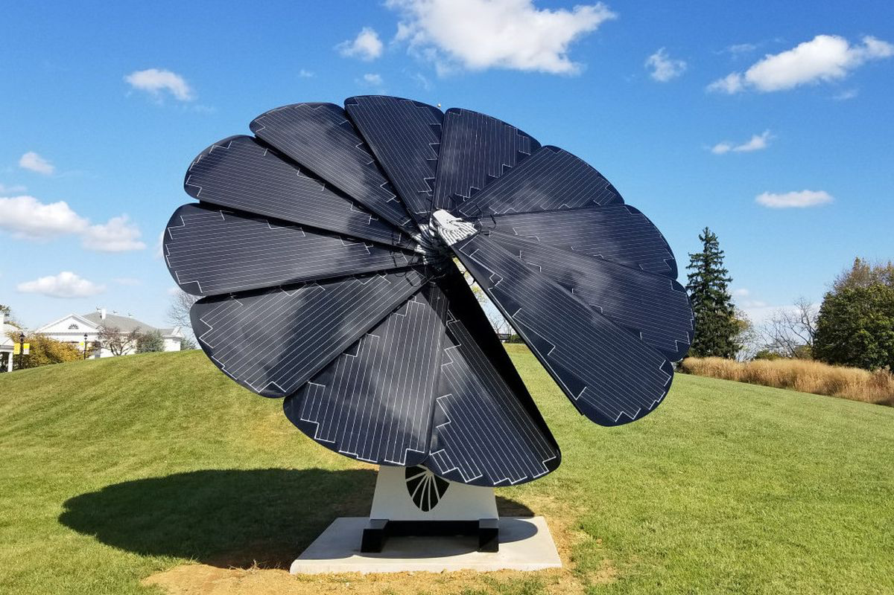
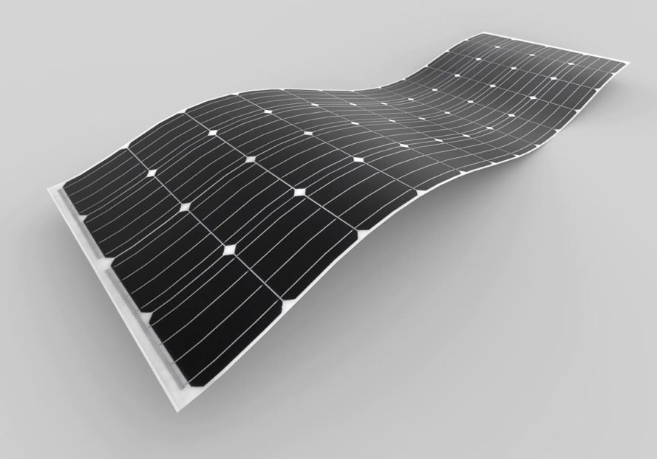

Slide 7
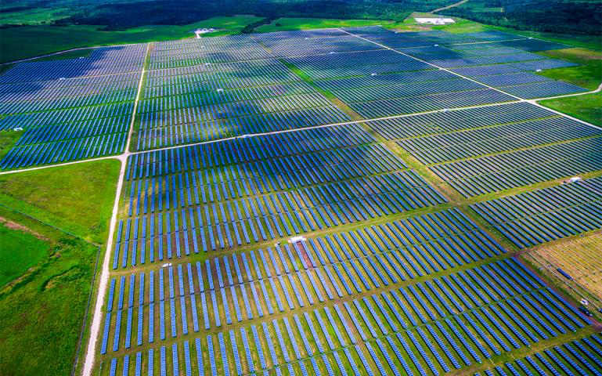

Slide 8
Arguments for solar fields
-can produce massive amounts of energy per day
-essential for providing stepping towards a green society
-unlimited power source
- high return on investments
-completely renewable

Slide 9
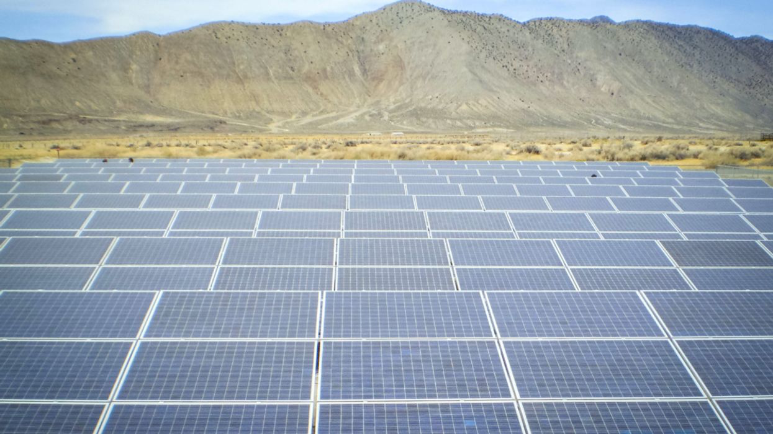

Slide 10
Arguments against solar fields
-less land that can be cultivated for agriculture
-takes up a lot of space
-environmental degradation and habitat loss

Slide 11
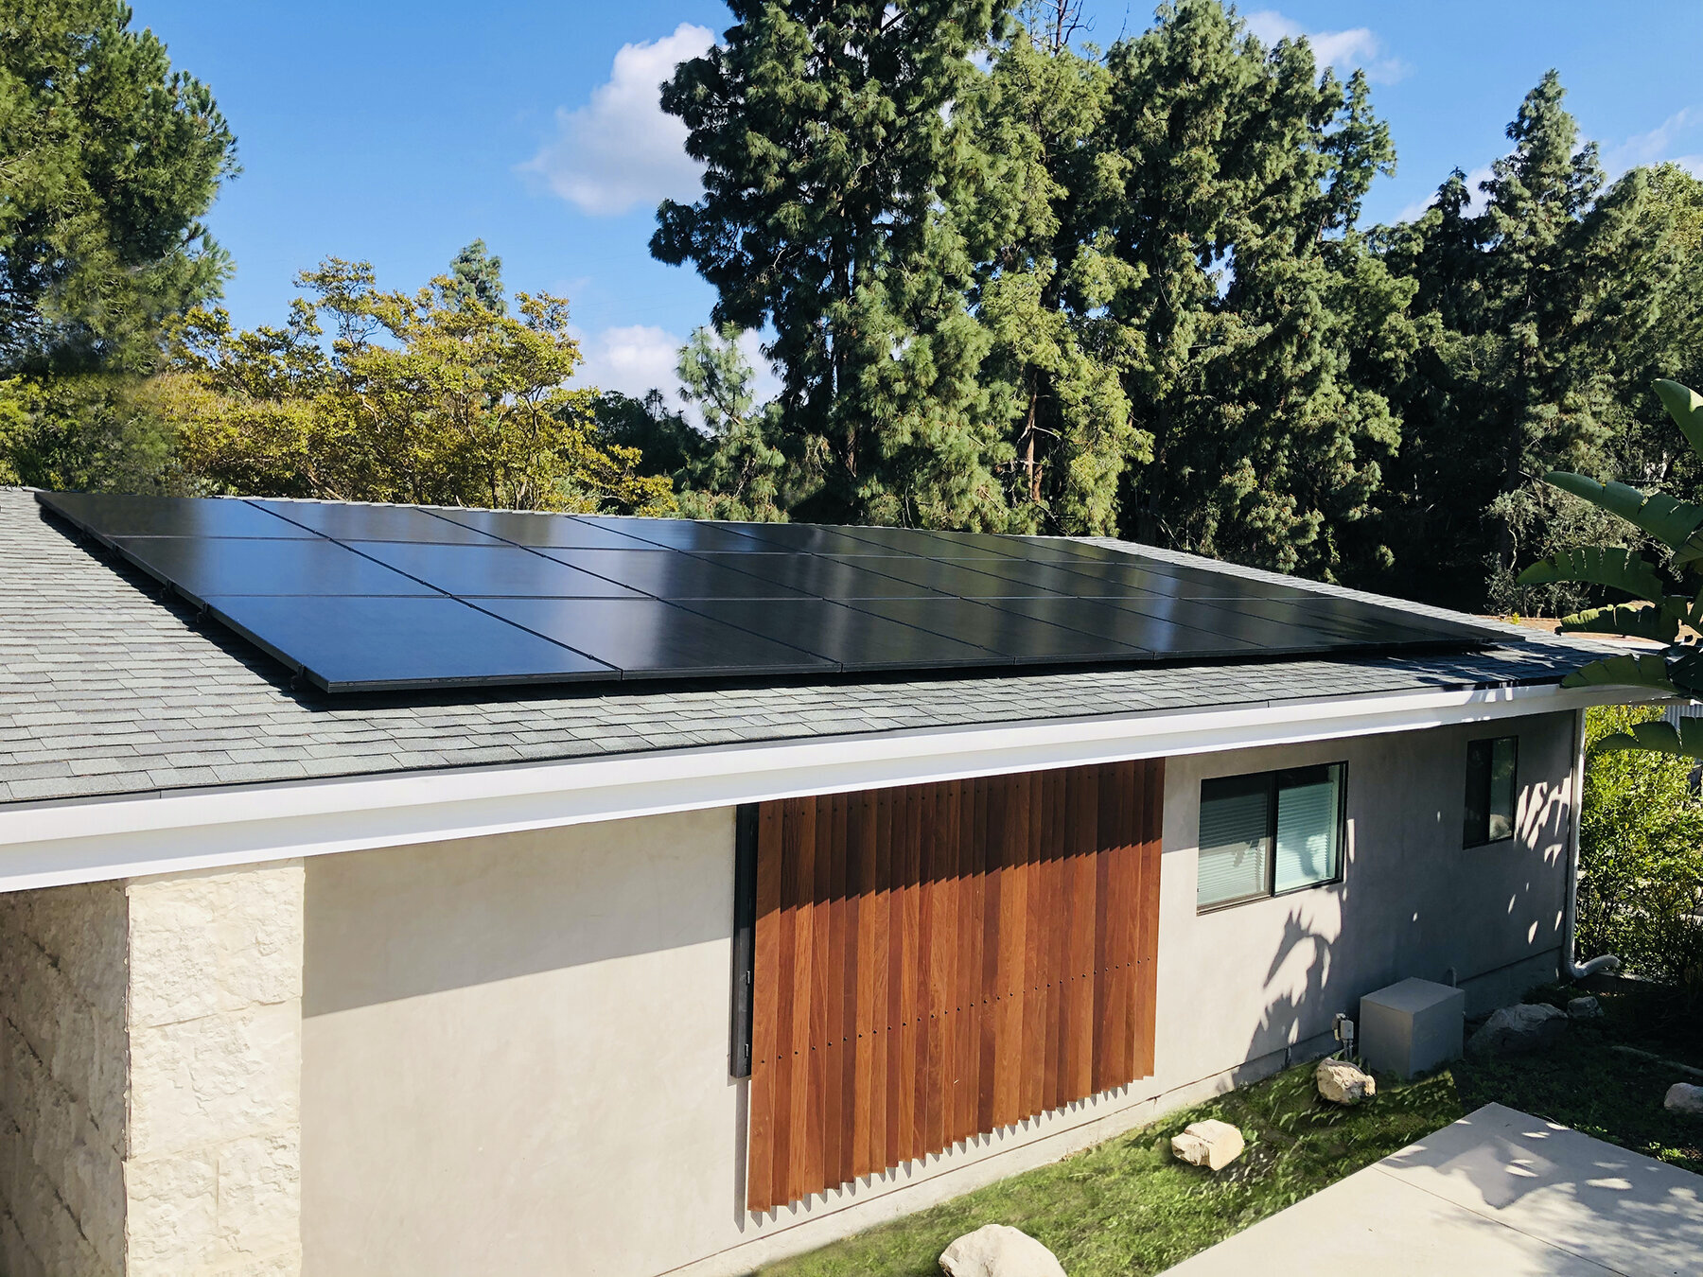

Slide 12
Discussion:
-Do you support solar panel fields? Would you install solar panels on your house?
-What other ways could we innovate solar panels to make them more widely used (ex. Solar windows)?
-How might we go about designating land for solar panels?
-Do you feel that it would be more efficient to have massive solar panel fields or to adapt solar to urban development?
-as a policymaker what are some incentives would you propose to increase the use of solar panels?
-why do you feel that our country and others have not been pushing harder towards adapting to solar?
-Would it be more efficient to have solar field in places where it is sunny majority of the time (egypt, Yuma, Nevada, California) rather than adapting them in urban development?

Slide 13
Sources
https://science.howstuffworks.com/environmental/energy/6-innovations-solar-power.htm
https://conservationtools.org/guides/182-solar-energy-development-and-land-conservation
https://www.pnas.org/content/112/44/13579
https://escholarship.org/content/qt62w112cg/qt62w112cg.pdf
https://www.nature.com/articles/s41598-021-82042-5
https://environment-review.yale.edu/reducing-land-use-impact-solar-energy-triple-win-climate-agriculture-and-biodiversity

