Slide 1
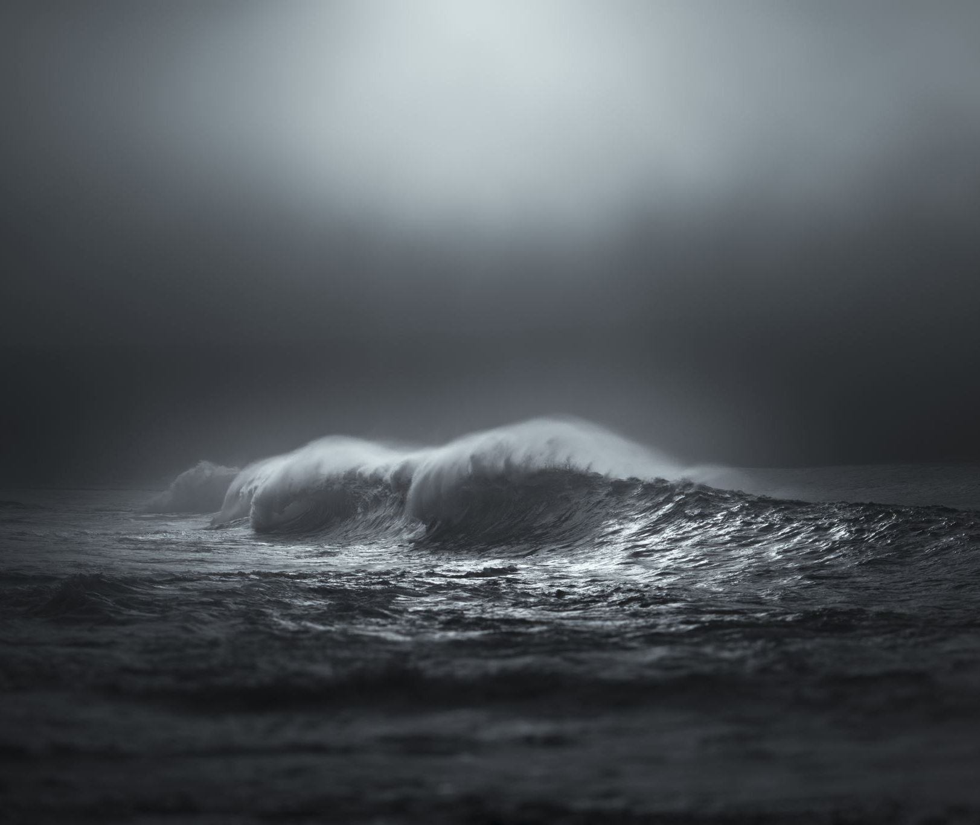
Global ice melt & Sea Level Rise

Slide 2
Open for Business(as usual) | RCP 8.5
Seawater’s thermal expansion along with melting mountain glaciers is predicted to lead to an increase in global sea level of 1.4-2.7 feet by 2100 under RCP 8.5 emissions scenario
Accelerated rates of Greenland ice sheet melt could make this scenario even worse
Paleoclimatic evidence suggests a warming of 3.6 F could lead to destruction of Greenland ice sheet, adding 16-20 feet to predicted SLR. Adversely affecting:
U.S. Gulf Coast
Eastern Seaboard (roughly 1/3 of Florida)
Netherlands
Belgium
Bangladesh
Major cities: Tokyo, New York, Mumbai, Shanghai, Dhaka

Slide 3
kinda NOT AS BAD | RCP 2.6
Thermal expansion, melting glaciers/ice sheets could lead to 1.4 feet of SLR
Projected mass reductions for polar glaciers between 2015 and 2100 range from 12 +/= 7%
Very likely that Arctic sea ice extent continues to decline in all months of the year
Reduction of stabilized Arctic autumn/spring snow by mid-century
Extreme seal level events to occur once per year before 2070
By 2100 near-surface permafrost area will decrease by 2-66%
Releasing more carbon dioxide and methane into the atmosphere
Adversely affecting wildlife habitats

Slide 4
Quick, how do we fix this??
What are some ideas to mitigate these issues?

Slide 5
We fixed it!
Dual focus on short-term and long-term adaptation efforts
Protecting areas
Community-based ecological monitoring
Relying and supporting Indigenous knowledge
Investing in human capital and resources
Funding for communities in need

Slide 6
Mommy, can you tell me a story?
Climate fatigue/apathy is real. Let’s fix that:
Repeated imagination work diminishes threats and negative associations
Audience members’ heartbeats align in rhythm during live theatrical experience
Comedy influences public opinion
Offer new routes to “knowing” about climate change
Engages new audiences
Increases retention of climate change information
Provides relief amid anxiety-producing news on climate change
Bridges difficult topics

Slide 7
Revenge of the (theatre) nerds
Climate Change Theatre Action and it’s widening reach
2019 Season and Anthology Lighting the Way
229 locations around the world (including all 50 US states)
Events incorporated 1,067 productions of the plays (each play performed 22 times on average)
Playwrights represented 15 different nation states | 55% BIPOC, 53% women or non-binary
CCTA 2019 presented at 78 universities around the world
3,046 artists, organizers and activists involved
over 26,000 people reached
12,613 live audience members | 10,415 via radio, podcast, livestream etc.

Slide 8
LAYLA PINES FOR THE WOLF

Slide 9
And how does that make you feel?
What did you like about this play? Dislike?
Did you learn something new?
How would you use this to educate people on climate change?
Did you think it had enough focus on science? Too much? Too little?
Did you think this was an effective way of communicating climate change?
If not, what would you change?
If so, would you see it working for people who don’t have any knowledge of climate change?

Slide 10
JOIN THE DARK SIDE!
Fall 2021 semester we will be producing THE CLIMATE CABARET
We will be partnering with Climate Change Theatre Action/The Arctic Cycle out of NYC
Producing 8 short plays about the climate crisis from the 2021 collection
A lot of opportunity for interdisciplinary collaboration
Emphasizing community engagement and action on climate change

Slide 11
Cite for sore eyes
https://www.ipcc.ch/site/assets/uploads/sites/3/2019/11/SROCC_FD_TS_Final.pdf
https://science.house.gov/hearings/disappearing-polar-bears-and-permafrost-is-a-global-warming-tipping-point-embedded-in-the-iced
https://www.britannica.com/science/global-warming/Ice-melt-and-sea-level-rise
https://www.sciencedaily.com/releases/2018/12/181210144943.htm
https://www.ucl.ac.uk/pals/news/2017/nov/audience-members-hearts-beat-together-theatre

